Slide 1
Stochastic Gradient Descent
Lecture 12
The core algorithm of modern machine learning

Slide 2



Do not edit How to change the design
Join at slido.com #3389863
The Slido app must be installed on every computer you’re presenting from

Slide 3
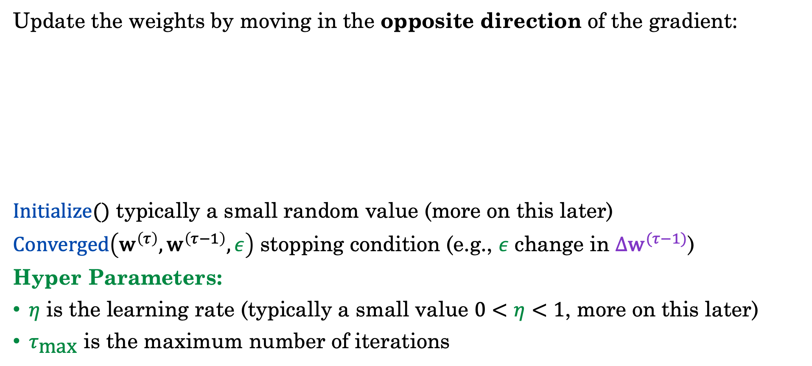
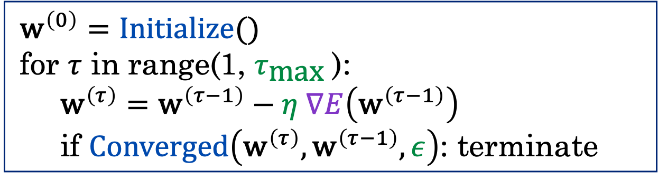
The (Batch) Gradient Descent Alg.
Update the weights by moving in the opposite direction of the gradient:
$Initialize()$ typically a small random value (more on this later)
$Converged\left({\text{w}}^{\left(τ\right)},{\text{w}}^{\left(τ−1\right)},ε\right)$ stopping condition (e.g., $ε$ change in ${Δ\text{w}}^{(τ−1)}$)
Hyper Parameters:
$η$ is the learning rate (typically a small value $0<η<1$, more on this later)
$τ_{\text{max}}$ is the maximum number of iterations
$${\text{w}}^{\left(0\right)}=Initialize()$$
for $τ$ in range(1, $τ_{\text{max}}$):
$${\text{w}}^{\left(τ\right)}={\text{w}}^{\left(τ−1\right)}−η ∇E\left({\text{w}}^{\left(τ−1\right)}\right)$$
if $Converged\left({\text{w}}^{\left(τ\right)},{\text{w}}^{\left(τ−1\right)}, ε\right)$: terminate
Notes:
Add tau max

Slide 4
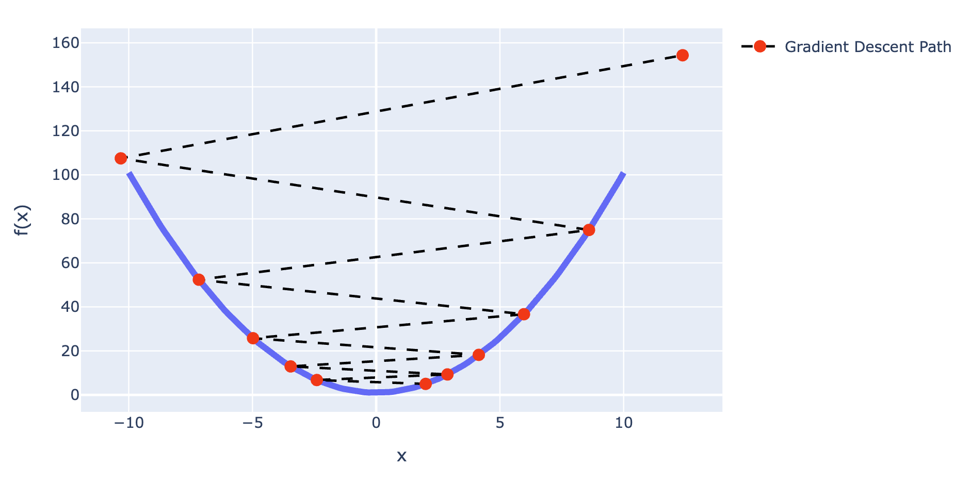
What are the conditions for convergence?
Learning rate seemed to affect convergence even on a simple parabola.

Slide 5
Convergence Assuming Quadratic Approximation

Slide 6
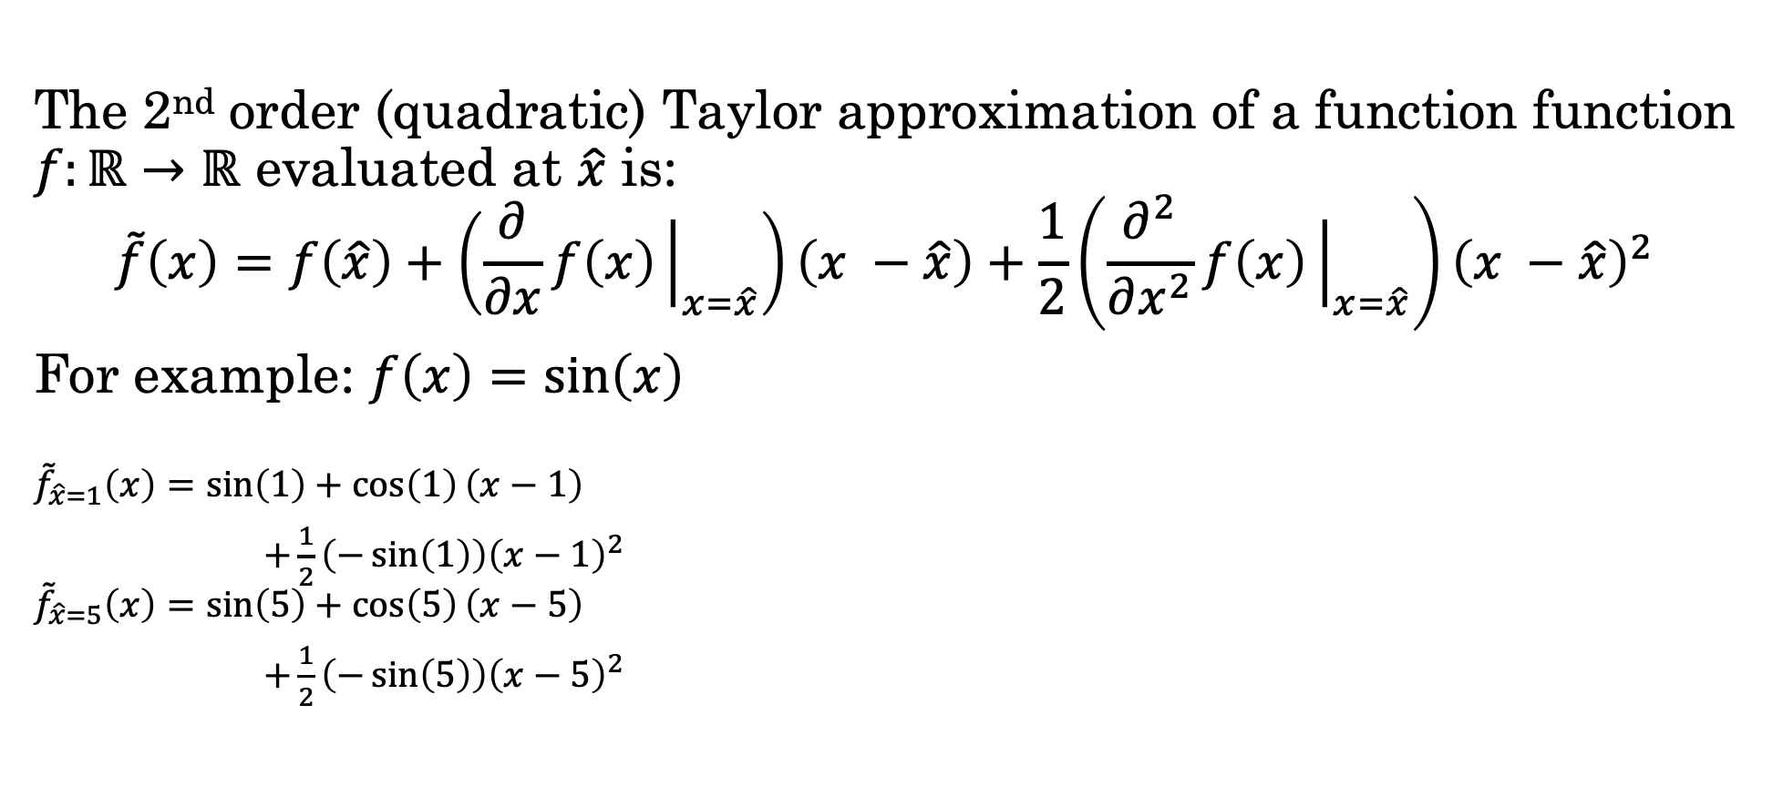
Quadratic Approximations
The 2nd order (quadratic) Taylor approximation of a function function $f:ℝ→ℝ$ evaluated at $\hat{x}$ is:
$$\tilde{f}\left(x\right)=f\left(\hat{x}\right)+\left(\frac{∂}{∂x}f\left(x\right){\left.​\right|}_{x=\hat{x}}\right)\left(x −\hat{x}\right)+\frac{1}{2}\left(\frac{∂^{2}}{∂x^{2}}f\left(x\right){\left.​\right|}_{x=\hat{x}}\right){\left(x −\hat{x}\right)}^{2}$$
For example: $f\left(x\right)=sin\left(x\right)$
$${\tilde{f}}_{\hat{x}=1}\left(x\right)=\sin\left(1\right)+\cos\left(1\right)\left(x−1\right)$$
$+\frac{1}{2}\left(−\sin\left(1\right)\right){\left(x−1\right)}^{2}$
$${\tilde{f}}_{\hat{x}=5}\left(x\right)=\sin\left(5\right)+\cos\left(5\right)\left(x−5\right)$$
$+\frac{1}{2}\left(−\sin\left(5\right)\right){\left(x−5\right)}^{2}$

Slide 7

Taylor Expansion of the Error Surface
The 2nd-order Taylor expansion of the error surface at $\hat{w}$:
$${\tilde{E}}_{\hat{w}}\left(w\right)=E\left(\hat{w}\right)+{\left(w−\hat{w}\right)}^{T}b+\frac{1}{2}{\left(w−\hat{w}\right)}^{T} H \left(w−\hat{w}\right)$$
$b=∇E\left(\hat{w}\right)$is the Gradient of E evaluated at $\hat{w}$ (vector)
$H=∇∇E\left(\hat{w}\right)$ is the Hessian of E evaluated at $\hat{w}$ (a matrix)
Matrix Equivalent of the Second Derivative

Slide 8
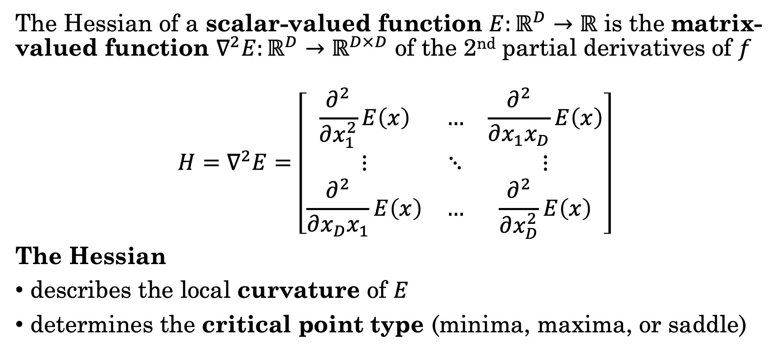
Hessians (the 2nd derivative)
The Hessian of a scalar-valued function $E:ℝ^{D}→ℝ$ is the matrix-valued function $∇^{2}E:ℝ^{D}→ℝ^{D×D}$ of the 2nd partial derivatives of $f$
$$H=∇^{2}E=\left[\begin{matrix}\frac{∂^{2}}{∂x_{1}^{2}}E\left(x\right) & … & \frac{∂^{2}}{∂x_{1}x_{D}}E\left(x\right) \\ ⋮ & ⋱ & ⋮ \\ \frac{∂^{2}}{∂x_{D}x_{1}}E\left(x\right) & … & \frac{∂^{2}}{∂x_{D}^{2}}E\left(x\right)\end{matrix}\right]$$
The Hessian
describes the local curvature of $E$
determines the critical point type (minima, maxima, or saddle)

Slide 9

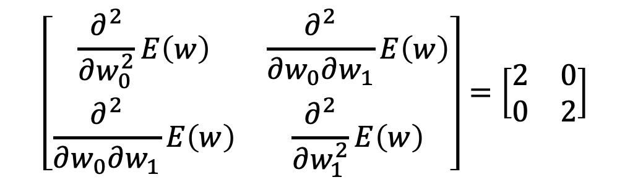
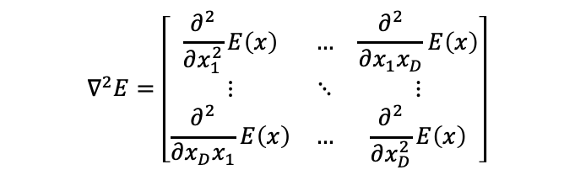


Hessian Exercise
3389863
Consider the function:
$E(w)={\left(w_{0}−1\right)}^{2}+{\left(w_{1}−2\right)}^{2}+1$
Then the gradient is: $∇E\left(w\right)=\left[\begin{aligned}2(w_{0}−1) \\ 2(w_{1}−2)\end{aligned}\right]$
The Hessian is:
$$\left[\begin{matrix}\frac{∂^{2}}{∂w_{0}^{2}}E\left(w\right) & \frac{∂^{2}}{∂w_{0}∂w_{1}}E\left(w\right) \\ \frac{∂^{2}}{∂w_{0}∂w_{1}}E\left(w\right) & \frac{∂^{2}}{∂w_{1}^{2}}E\left(w\right)\end{matrix}\right]=\left[\begin{matrix}2 & 0 \\ 0 & 2\end{matrix}\right]$$
$$H\left(w\right)=$$
Hessian
$$∇^{2}E=\left[\begin{matrix}\frac{∂^{2}}{∂x_{1}^{2}}E\left(x\right) & … & \frac{∂^{2}}{∂x_{1}x_{D}}E\left(x\right) \\ ⋮ & ⋱ & ⋮ \\ \frac{∂^{2}}{∂x_{D}x_{1}}E\left(x\right) & … & \frac{∂^{2}}{∂x_{D}^{2}}E\left(x\right)\end{matrix}\right]$$
Plots in demo notebook.

Slide 10
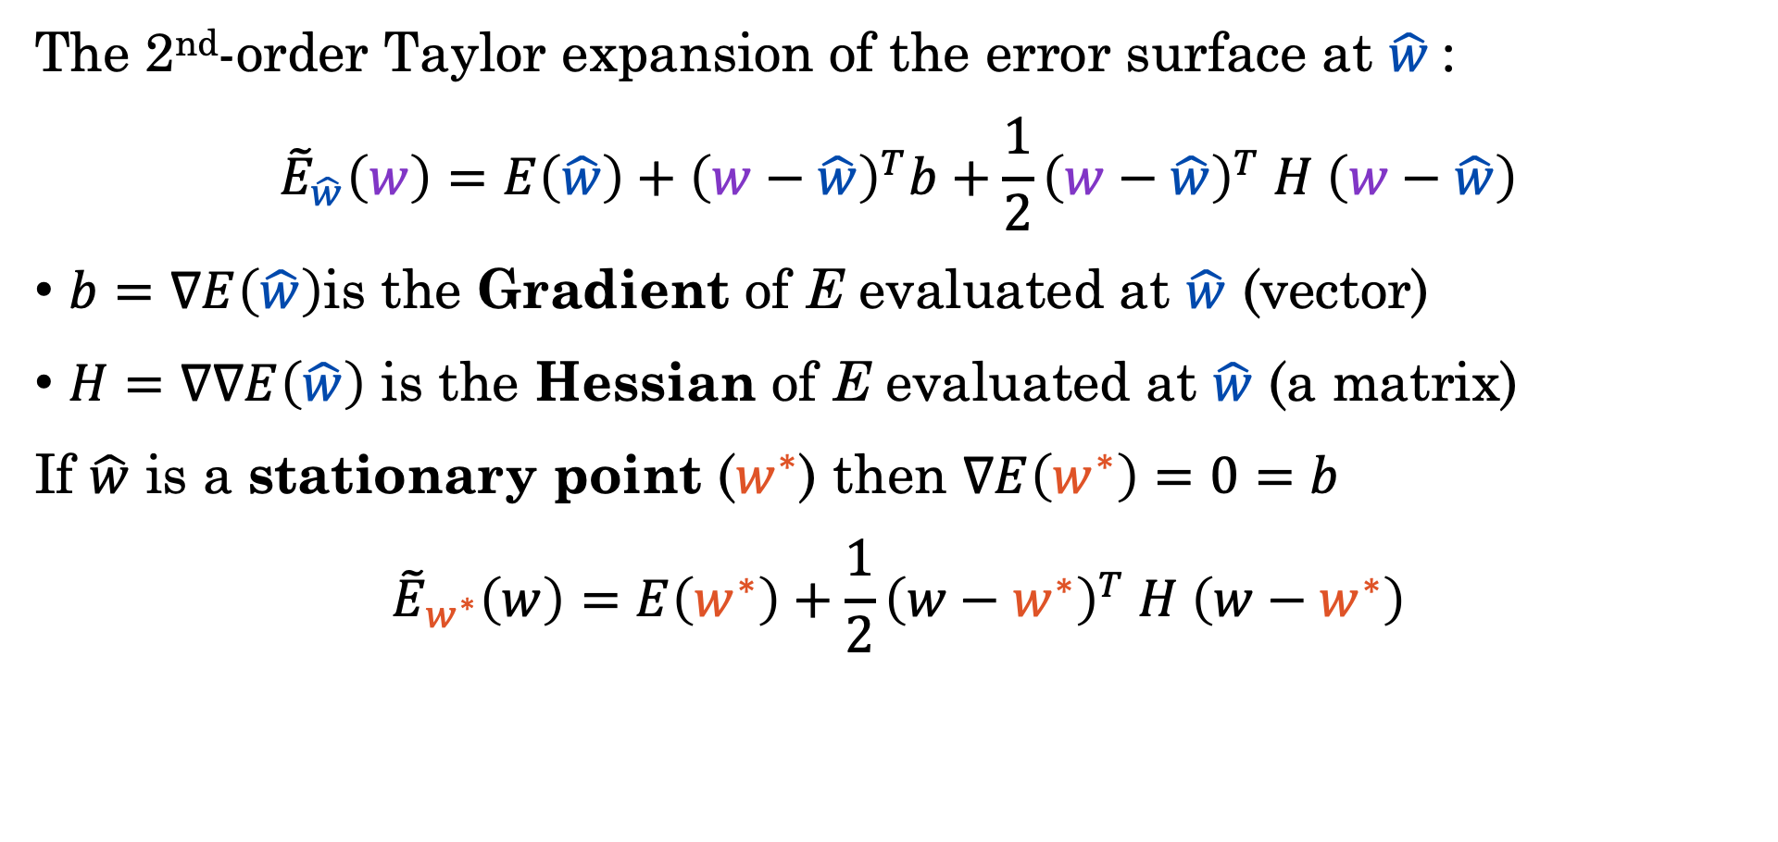
Taylor Expansion of the Error Surface
The 2nd-order Taylor expansion of the error surface at $\hat{w}$:
$${\tilde{E}}_{\hat{w}}\left(w\right)=E\left(\hat{w}\right)+{\left(w−\hat{w}\right)}^{T}b+\frac{1}{2}{\left(w−\hat{w}\right)}^{T} H \left(w−\hat{w}\right)$$
$b=∇E\left(\hat{w}\right)$is the Gradient of E evaluated at $\hat{w}$ (vector)
$H=∇∇E\left(\hat{w}\right)$ is the Hessian of E evaluated at $\hat{w}$ (a matrix)
If $\hat{w}$ is a stationary point ($w^{∗}$) then $∇E\left(w^{∗}\right)=0=b$
$${\tilde{E}}_{w^{∗}}\left(w\right)=E\left(w^{∗}\right)+\frac{1}{2}{\left(w−w^{∗}\right)}^{T} H \left(w−w^{∗}\right)$$
Use a change of variables to better understand this part.

Slide 11
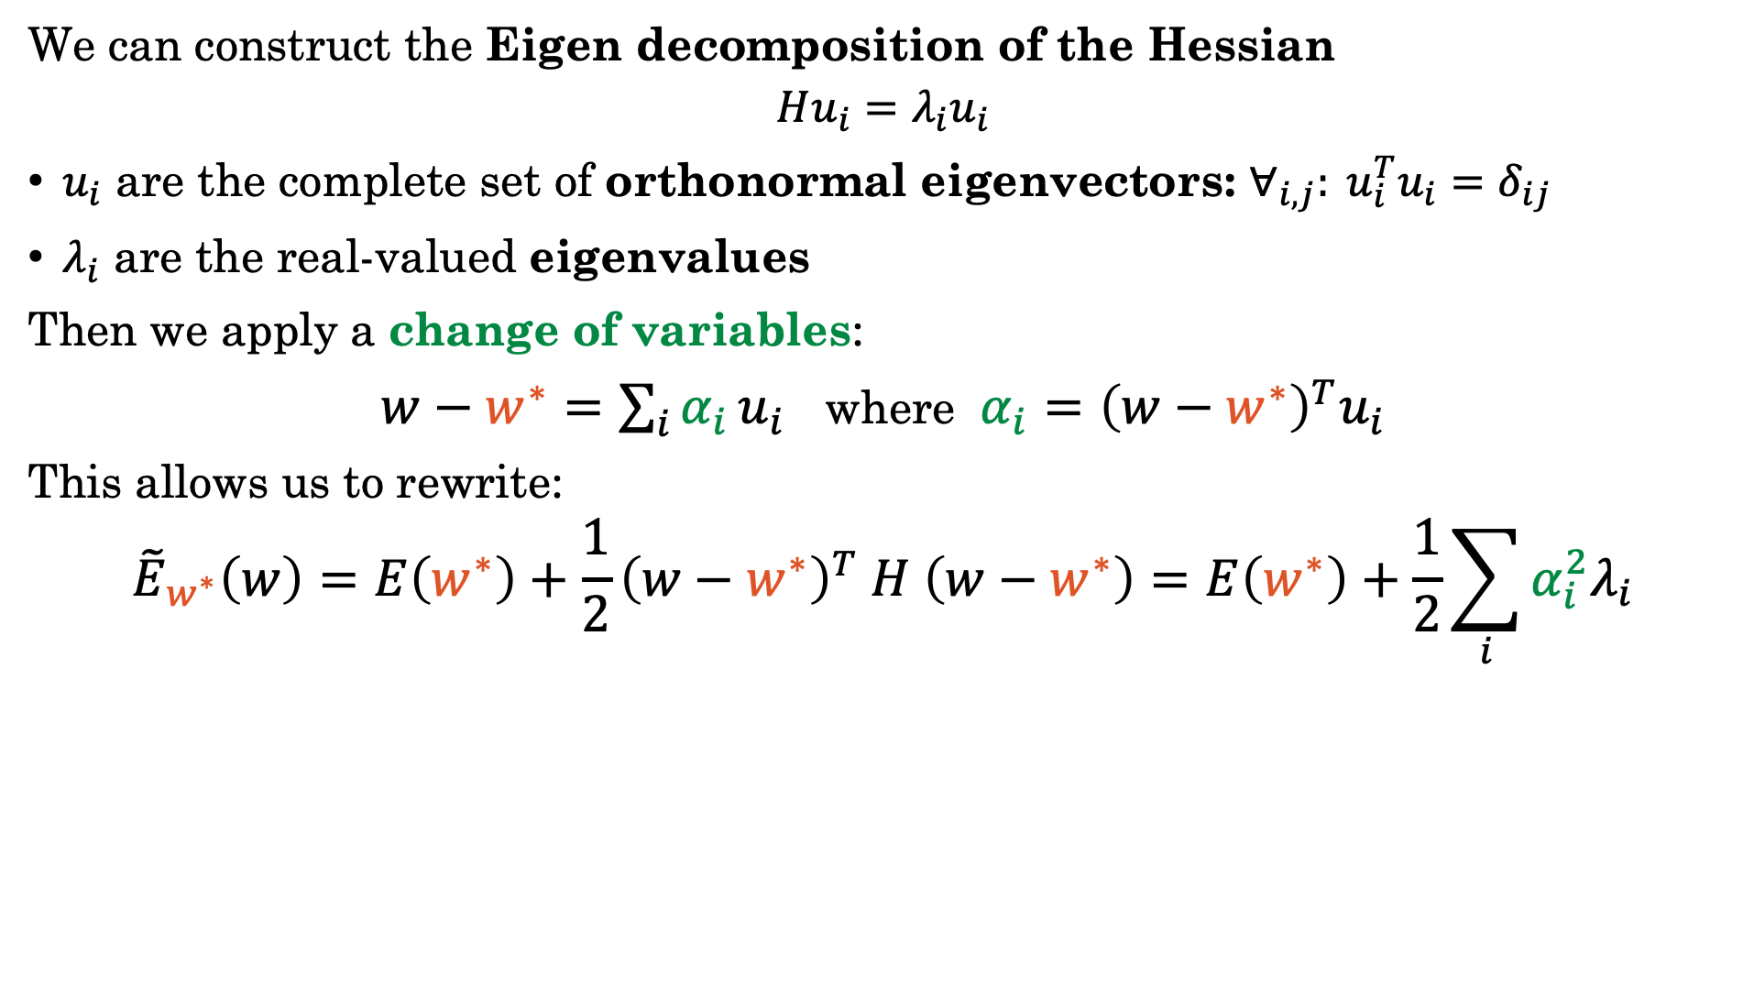
Eigen Decomposition of the Hessian
We can construct the Eigen decomposition of the Hessian
$$Hu_{i}=λ_{i}u_{i}$$
$u_{i}$ are the complete set of orthonormal eigenvectors: $∀_{i,j}: u_{i}^{T}u_{i}=δ_{ij}$
$λ_{i}$ are the real-valued eigenvalues
Then we apply a change of variables:
$w−w^{∗}=\sum_{i}{α_{i}}u_{i}$ where $α_{i}={\left(w−w^{∗}\right)}^{T}u_{i}$
This allows us to rewrite:
$${\tilde{E}}_{w^{∗}}\left(w\right)=E\left(w^{∗}\right)+\frac{1}{2}{\left(w−w^{∗}\right)}^{T} H \left(w−w^{∗}\right)=E\left(w^{∗}\right)+\frac{1}{2}\sum_{i}{α_{i}^{2}λ_{i}}$$
Show it!
Notes:
\alpha = U^T (w-w^*)
U * \alpha = U * U^T (w-w^*) = w-w^*

Slide 12
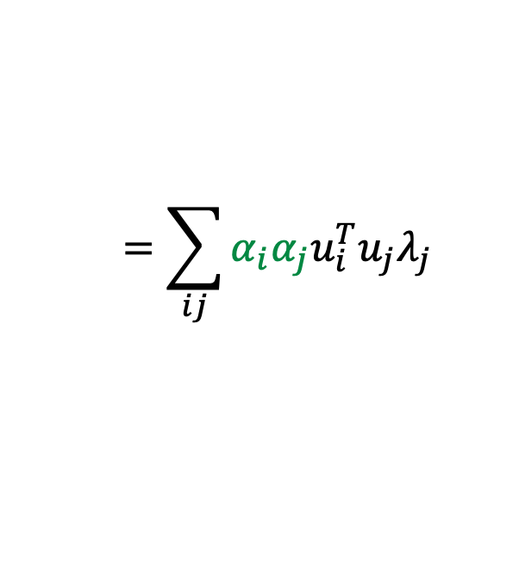

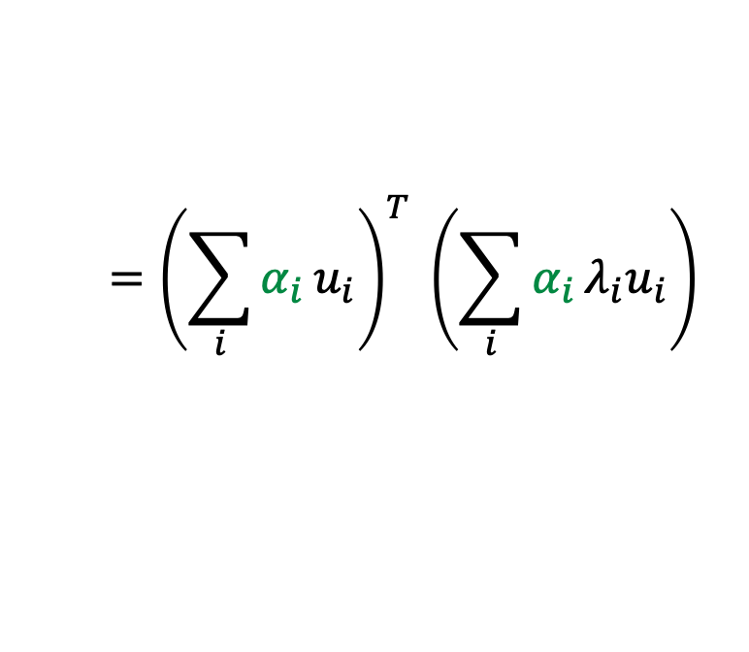
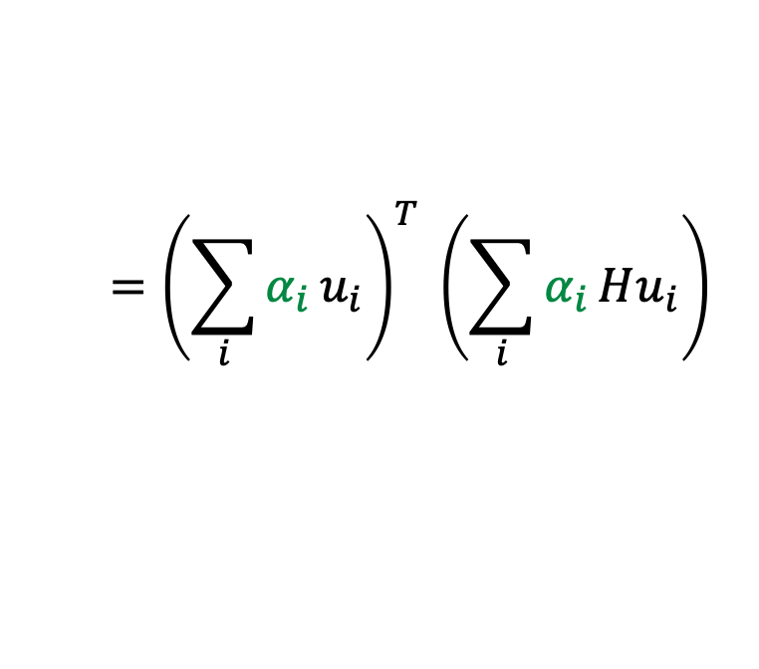
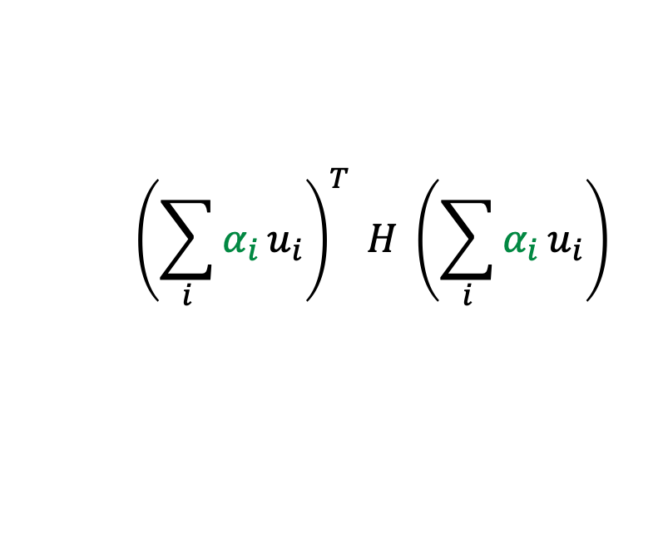
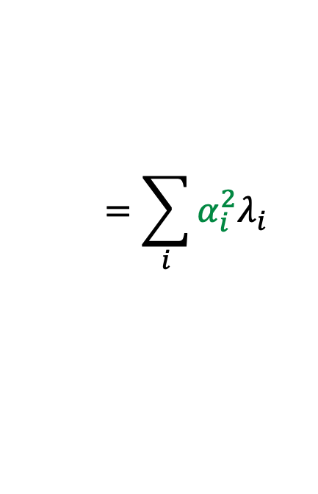

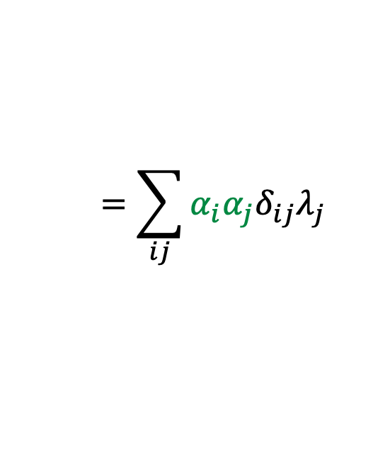
Eigen Decomposition of the Hessian
We can construct the Eigen decomposition of the Hessian
$$Hu_{i}=λ_{i}u_{i}$$
$u_{i}$ are the complete set of orthonormal eigenvectors: $∀_{i,j}: u_{i}^{T}u_{i}=δ_{ij}$
$λ_{i}$ are the real-valued eigenvalues
Then we apply a change of variables:
$w−w^{∗}=\sum_{i}{α_{i}}u_{i}$ where $α_{i}={\left(w−w^{∗}\right)}^{T}u_{i}$
This allows us to rewrite:
$${\tilde{E}}_{w^{∗}}\left(w\right)=E\left(w^{∗}\right)+\frac{1}{2}{\left(w−w^{∗}\right)}^{T} H \left(w−w^{∗}\right)=E\left(w^{∗}\right)+\frac{1}{2}\sum_{i}{α_{i}^{2}λ_{i}}$$
Show it!
Derivation:
$${\left(\sum_{i}{α_{i}}u_{i}\right)}^{T} H \left(\sum_{i}{α_{i}}u_{i}\right)$$
$$={\left(\sum_{i}{α_{i}}u_{i}\right)}^{T} \left(\sum_{i}{α_{i}}Hu_{i}\right)$$
$${\left(w−w^{∗}\right)}^{T} H \left(w−w^{∗}\right)=$$
$$={\left(\sum_{i}{α_{i}}u_{i}\right)}^{T} \left(\sum_{i}{α_{i}}λ_{i}u_{i}\right)$$
$$=\sum_{ij}{α_{i}α_{j}u_{i}^{T}u_{j}λ_{j}}$$
$$=\sum_{ij}{α_{i}α_{j}δ_{ij}λ_{j}}$$
$$=\sum_{i}{α_{i}^{2}λ_{i}}$$
Eigenvector Defn.
Orthonormality
Notes:
\alpha = U^T (w-w^*)
U * \alpha = U * U^T (w-w^*) = w-w^*

Slide 13
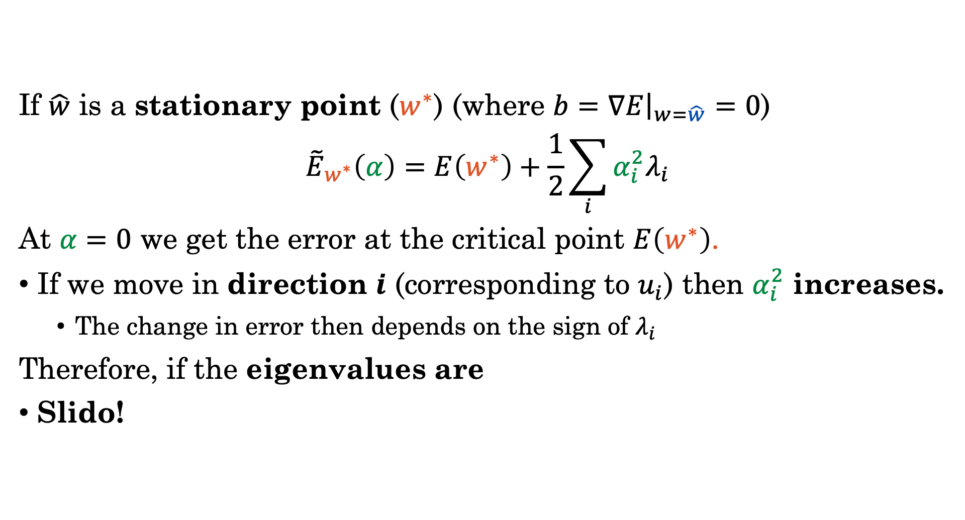
Taylor Expansion at the Stationary Pts.
If $\hat{w}$ is a stationary point ($w^{∗}$) (where $b=∇E{\left.​\right|}_{w=\hat{w}}=0$)
$${\tilde{E}}_{w^{∗}}\left(α\right)=E\left(w^{∗}\right)+\frac{1}{2}\sum_{i}{α_{i}^{2}λ_{i}}$$
At $α=0$ we get the error at the critical point $E\left(w^{∗}\right)$.
If we move in direction $i$ (corresponding to $u_{i}$) then $α_{i}^{2}$ increases.
The change in error then depends on the sign of $λ_{i}$
Therefore, if the eigenvalues are
Slido!
Notes:
Move the goal earlier and then the derivation

Slide 14

Do not edit How to change the design
If the eigen values at w* are all positive then
The Slido app must be installed on every computer you’re presenting from

Slide 15
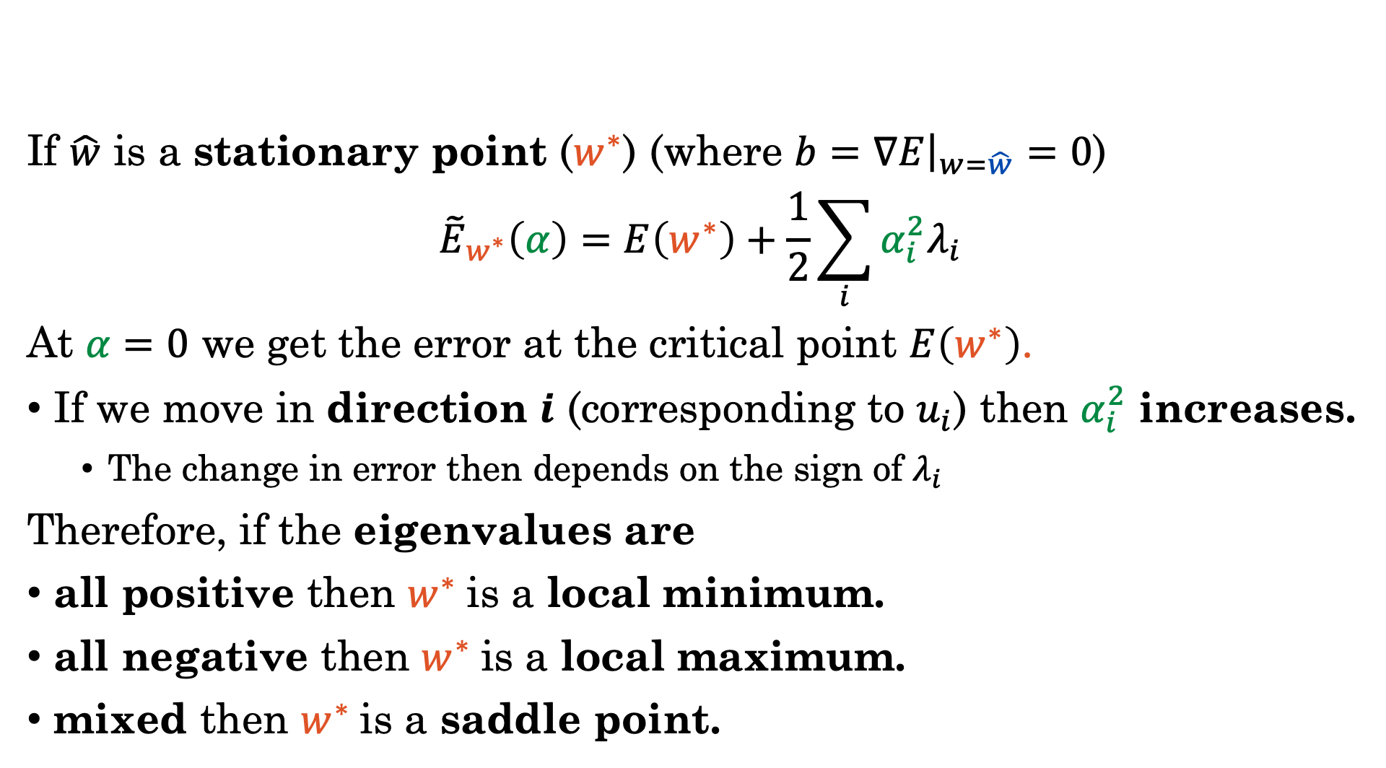
Taylor Expansion at the Stationary Pts.
If $\hat{w}$ is a stationary point ($w^{∗}$) (where $b=∇E{\left.​\right|}_{w=\hat{w}}=0$)
$${\tilde{E}}_{w^{∗}}\left(α\right)=E\left(w^{∗}\right)+\frac{1}{2}\sum_{i}{α_{i}^{2}λ_{i}}$$
At $α=0$ we get the error at the critical point $E\left(w^{∗}\right)$.
If we move in direction $i$ (corresponding to $u_{i}$) then $α_{i}^{2}$ increases.
The change in error then depends on the sign of $λ_{i}$
Therefore, if the eigenvalues are
all positive then $w^{∗}$is a local minimum.
all negative then $w^{∗}$is a local maximum.
mixed then $w^{∗}$is a saddle point.
Notes:
Move the goal earlier and then the derivation

Slide 16
Stationary Points and the Hessian
Eigenvalues of the Hessian determine the curvature at the critical points
Minimum
Maximum
Saddle Point

Slide 17
Do not edit How to change the design
The eigenvector u1 corresponds to the:
The Slido app must be installed on every computer you’re presenting from

Slide 18
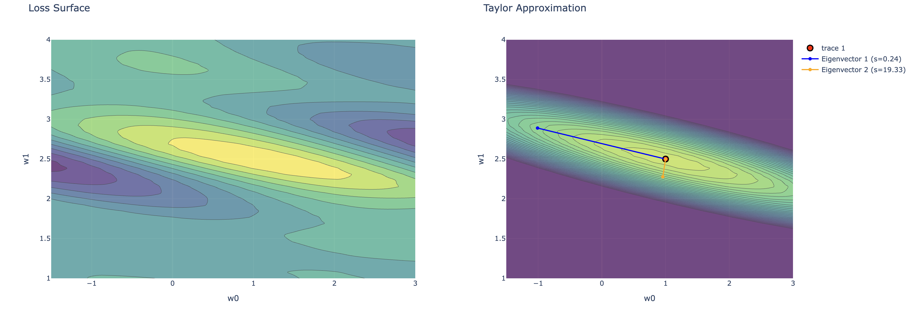



Eigenvectors of the Hessian
Elliptical contours of constant error align with the eigenvectors of the Hessian matrix.
Direction with Smallest Eigenvalue
$$u_{1}$$
$$w^{∗}$$
$$u_{2}$$
Direction with Largest Eigenvalue
Plots in demo notebook.

Slide 19
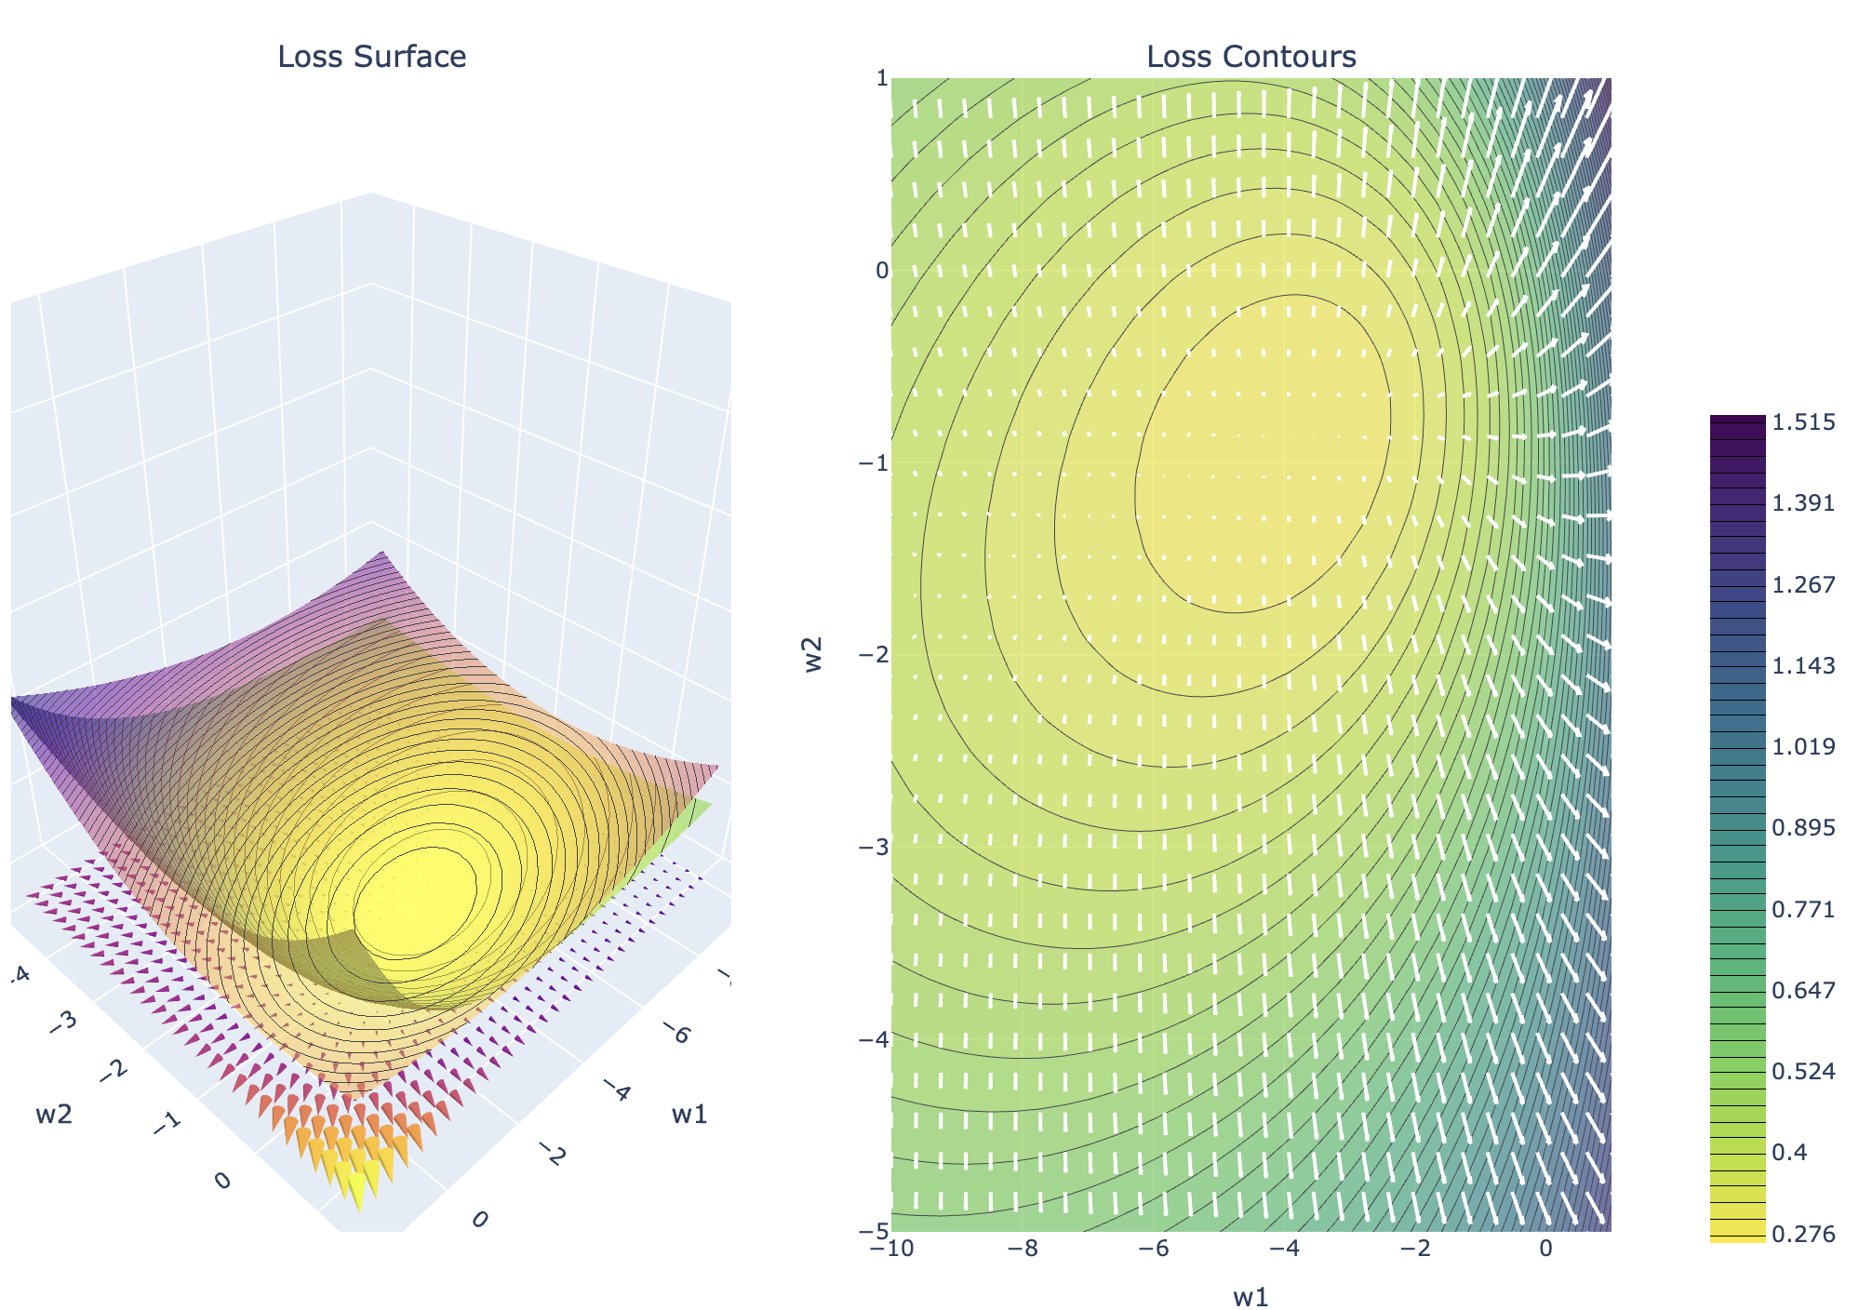
Demo
3389863
Taylor Expansions and the Hessian

Slide 20
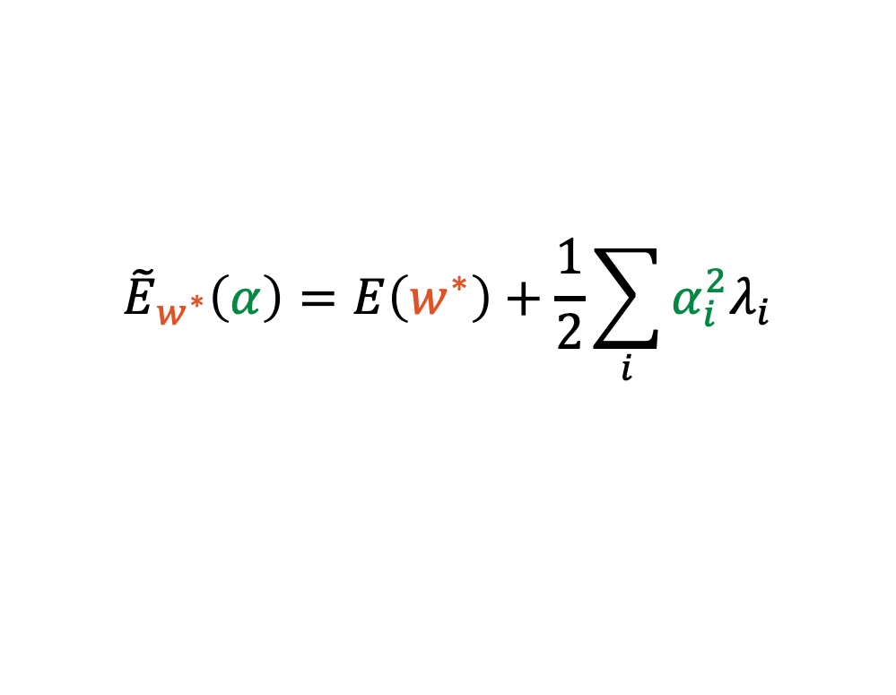
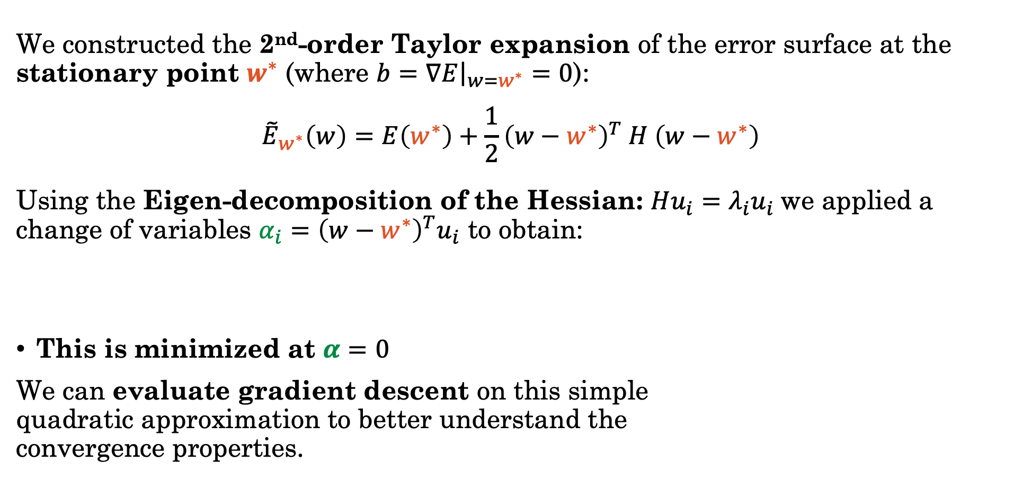



Recap: Quadratic Approx. Error
We constructed the 2nd-order Taylor expansion of the error surface at the stationary point $w^{∗}$ (where $b=∇E{\left.​\right|}_{w=w^{∗}}=0$):
$${\tilde{E}}_{w^{∗}}\left(w\right)=E\left(w^{∗}\right)+\frac{1}{2}{\left(w−w^{∗}\right)}^{T} H \left(w−w^{∗}\right)$$
Using the Eigen-decomposition of the Hessian: $Hu_{i}=λ_{i}u_{i}$we applied a change of variables $α_{i}={\left(w−w^{∗}\right)}^{T}u_{i}$ to obtain:
This is minimized at $α=0$
We can evaluate gradient descent on this simple quadratic approximation to better understand the convergence properties.
$${\tilde{E}}_{w^{∗}}\left(α\right)=E\left(w^{∗}\right)+\frac{1}{2}\sum_{i}{α_{i}^{2}λ_{i}}$$
$$u_{1}$$
$$w^{∗}$$
$$u_{2}$$

Slide 21
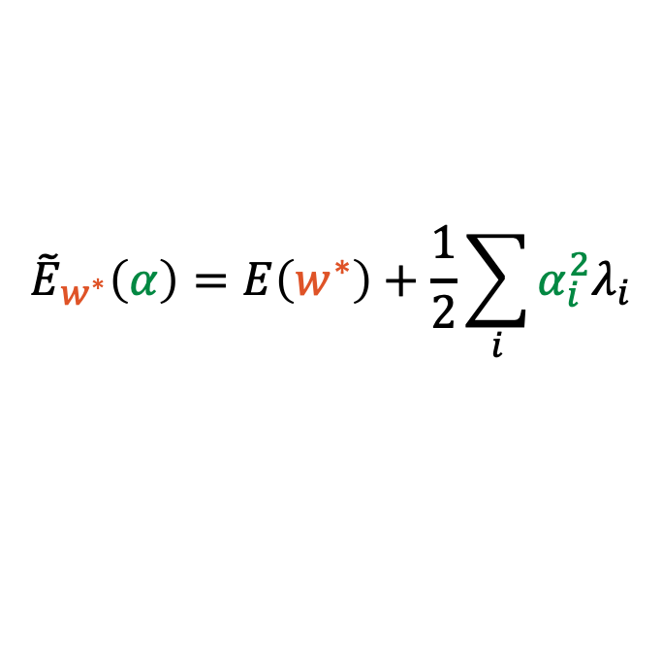
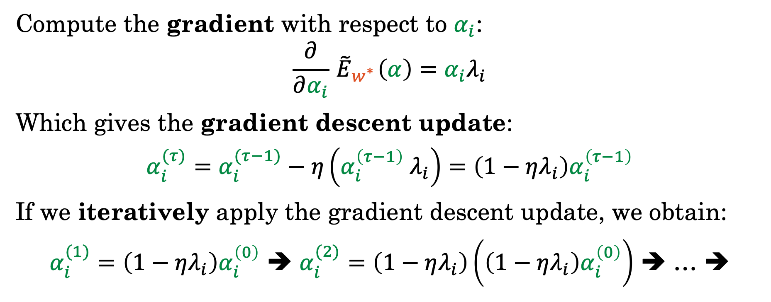

Grad. Descent on the Quadratic Approx.
Quadratic Approx. Error
Compute the gradient with respect to $α_{i}$:
$$\frac{∂}{∂α_{i}}{ \tilde{E}}_{w^{∗}}\left(α\right)=α_{i}λ_{i}$$
Which gives the gradient descent update:
$$α_{i}^{(τ)}=α_{i}^{(τ−1)}−η\left(α_{i}^{\left(τ−1\right)} λ_{i}\right)=\left(1−ηλ_{i}\right)α_{i}^{\left(τ−1\right)}$$
If we iteratively apply the gradient descent update, we obtain:
$α_{i}^{(1)}=\left(1−ηλ_{i}\right)α_{i}^{\left(0\right)}$ ➔ $α_{i}^{(2)}=\left(1−ηλ_{i}\right)\left(\left(1−ηλ_{i}\right)α_{i}^{\left(0\right)}\right)$ ➔ … ➔
$${\tilde{E}}_{w^{∗}}\left(α\right)=E\left(w^{∗}\right)+\frac{1}{2}\sum_{i}{α_{i}^{2}λ_{i}}$$
$$α_{i}^{(τ)}={\left(1−ηλ_{i}\right)}^{τ}α_{i}^{\left(0\right)}$$

Slide 22
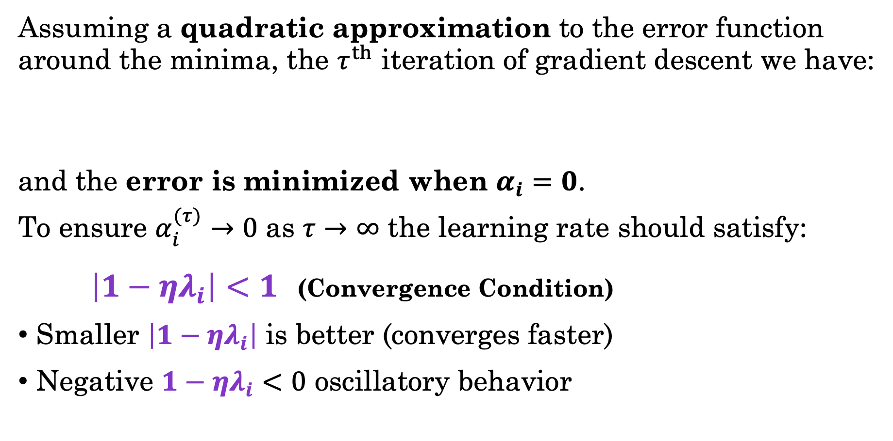

Grad. Descent on the Quadratic Approx.
Assuming a quadratic approximation to the error function around the minima, the $τ^{th}$ iteration of gradient descent we have:
and the error is minimized when $α_{i}=0$.
To ensure $α_{i}^{(τ)}→0$ as $τ→∞$ the learning rate should satisfy:
$\left|1−ηλ_{i}\right|<1$ (Convergence Condition)
Smaller $\left|1−ηλ_{i}\right|$ is better (converges faster)
Negative $1−ηλ_{i}<0$ oscillatory behavior
$$α_{i}^{(τ)}={\left(1−ηλ_{i}\right)}^{τ}α_{i}^{\left(0\right)}$$

Slide 23
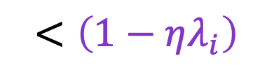
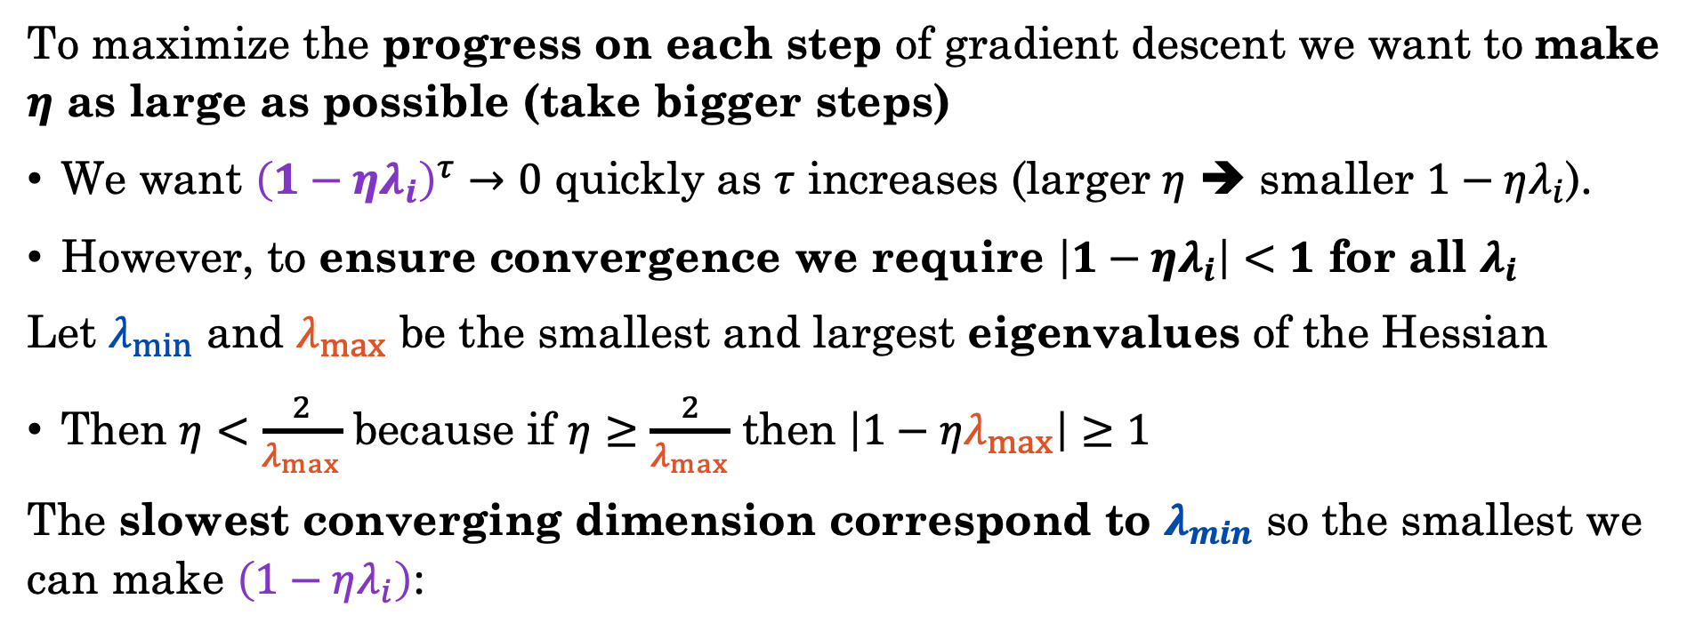
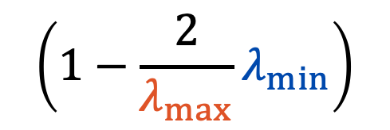
Learning Rate Impact on Convergence
To maximize the progress on each step of gradient descent we want to make $η$ as large as possible (take bigger steps)
We want ${\left(1−ηλ_{i}\right)}^{τ}→0$ quickly as $τ$ increases (larger $η$ ➔ smaller $1−ηλ_{i}$).
However, to ensure convergence we require $\left|1−ηλ_{i}\right|<1$ for all $λ_{i}$
Let $λ_{min}$ and $λ_{max}$ be the smallest and largest eigenvalues of the Hessian
Then $η<\frac{2}{λ_{max}}$ because if $η≥\frac{2}{λ_{max}}$ then $\left|1−ηλ_{max}\right|≥1$
The slowest converging dimension correspond to $λ_{min}$ so the smallest we can make $\left(1−ηλ_{i}\right)$:
$$\left(1−\frac{2}{λ_{max}}λ_{min⁡}\right)$$
$$<\left(1−ηλ_{i}\right)$$

Slide 24
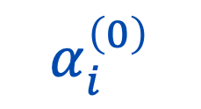
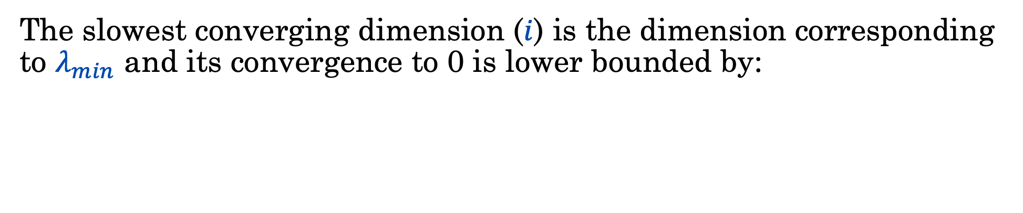


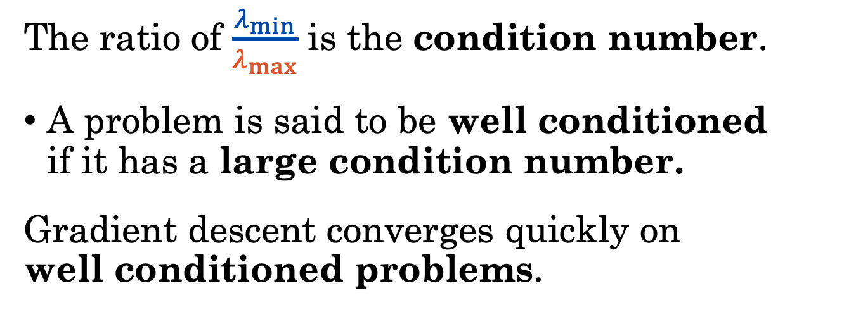


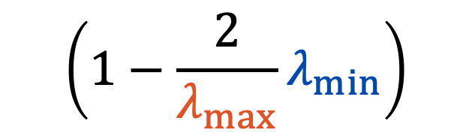
Condition Number and Loss Surface
The slowest converging dimension ($i$) is the dimension corresponding to $λ_{min}$ and its convergence to 0 is lower bounded by:
$$τ$$
$$\left(1−\frac{2}{λ_{max}}λ_{min⁡}\right)$$
$$α_{i}^{\left(0\right)}$$
Direction with Smallest Eigenvalue
The ratio of $\frac{λ_{min}}{λ_{max}}$ is the condition number.
A problem is said to be well conditioned if it has a large condition number.
Gradient descent converges quickly on well conditioned problems.
$$u_{min}$$
$$w^{∗}$$
$$u_{max}$$
Direction with Largest Eigenvalue

Slide 25
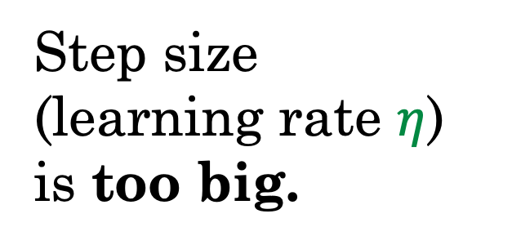
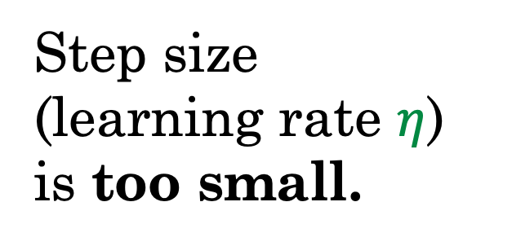
Issues with Gradient Descent (GD)
GD converges slowly when the error surface is relatively flat:
GD oscillates when the error surface is poorly conditioned
Step size
(learning rate $η$) is too small.
Step size
(learning rate $η$) is too big.

Slide 26
Demo
Oscillating convergence

Slide 27
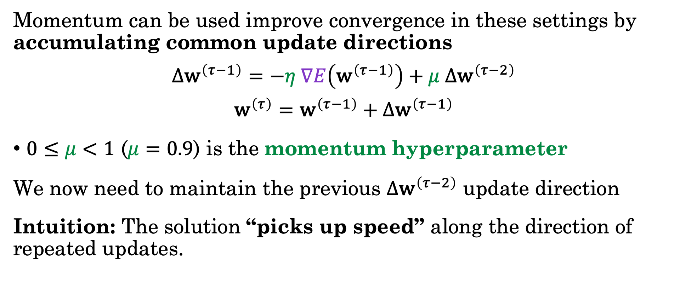
Momentum
Momentum can be used improve convergence in these settings by accumulating common update directions
$$Δ{\text{w}}^{\left(τ−1\right)}=−η ∇E\left({\text{w}}^{\left(τ−1\right)}\right)+μ Δ{\text{w}}^{\left(τ−2\right)}$$
$${\text{w}}^{\left(τ\right)}={\text{w}}^{\left(τ−1\right)}+Δ{\text{w}}^{\left(τ−1\right)}$$
$0≤μ<1$ ($μ=0.9$) is the momentum hyperparameter
We now need to maintain the previous $Δ{\text{w}}^{\left(τ−2\right)}$ update direction
Intuition: The solution “picks up speed” along the direction of repeated updates.

Slide 28
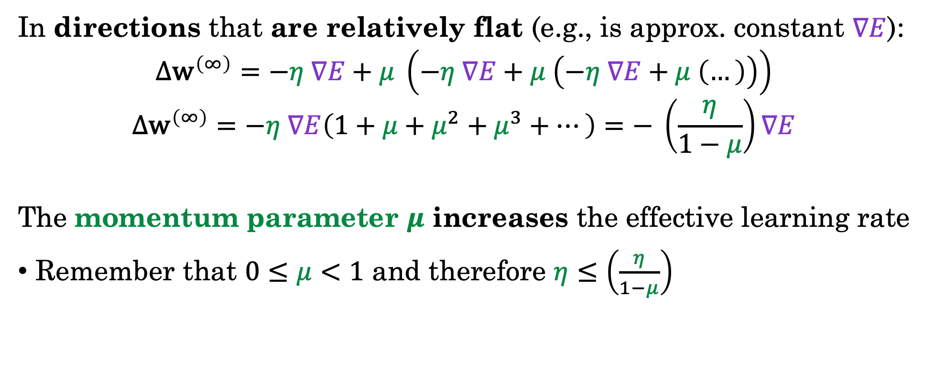
How Momentum Helps with Flat Dir.
In directions that are relatively flat (e.g., is approx. constant $∇E$):
$$Δ{\text{w}}^{\left(∞\right)}=−η ∇E+μ \left(−η ∇E+μ \left(−η ∇E+μ \left(…\right)\right)\right)$$
$$Δ{\text{w}}^{\left(∞\right)}=−η ∇E\left(1+μ+μ^{2}+μ^{3}+…\right)=− \left(\frac{η}{1−μ}\right)∇E$$
The momentum parameter $μ$ increases the effective learning rate
Remember that $0≤μ<1$ and therefore $η≤\left(\frac{η}{1−μ}\right)$
Geometric Series

Slide 29
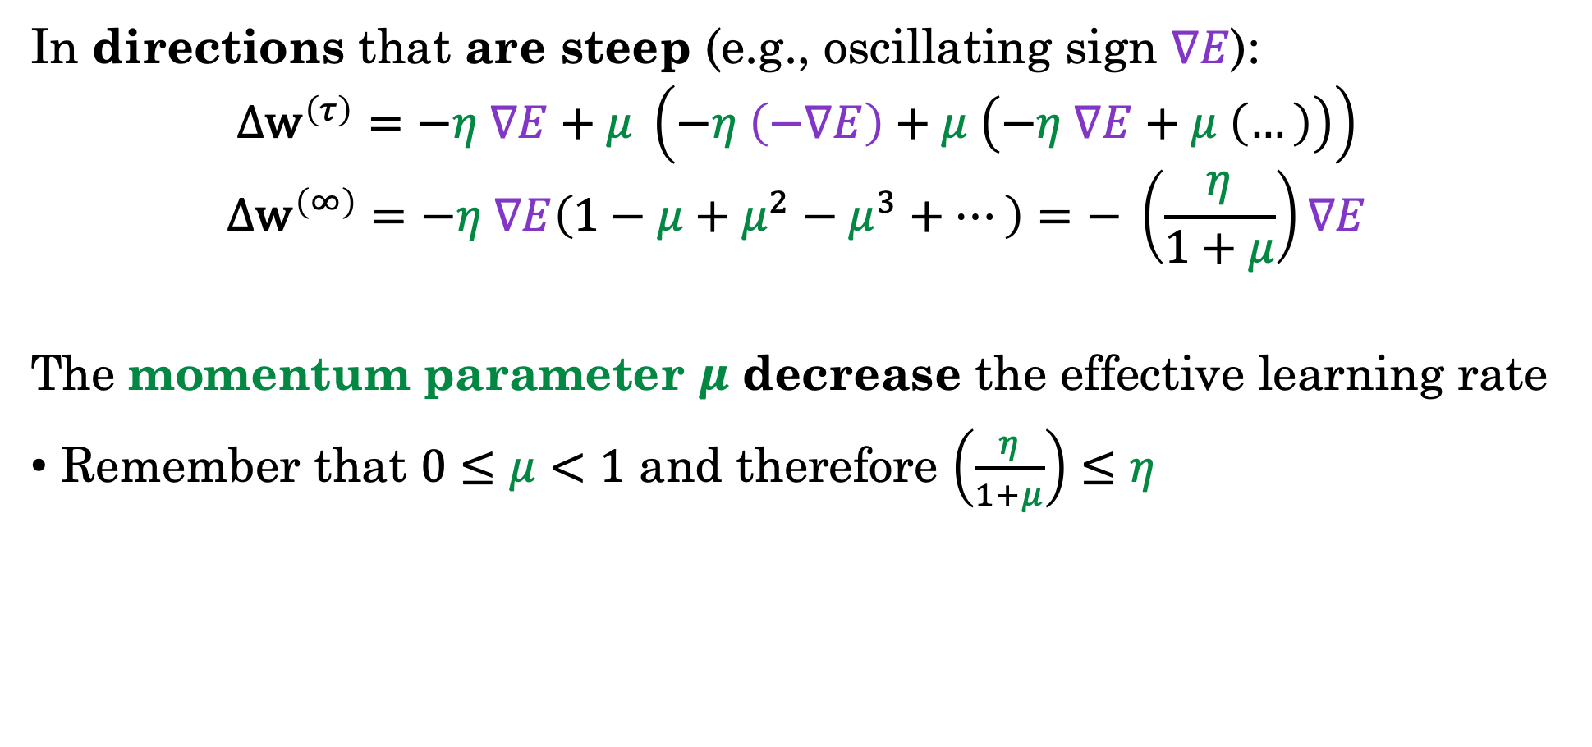
How Momentum Helps with Oscillations
In directions that are steep (e.g., oscillating sign $∇E$):
$$Δ{\text{w}}^{\left(τ\right)}=−η ∇E+μ \left(−η \left(−∇E\right)+μ \left(−η ∇E+μ \left(…\right)\right)\right)$$
$$Δ{\text{w}}^{\left(∞\right)}=−η ∇E\left(1−μ+μ^{2}−μ^{3}+…\right)=− \left(\frac{η}{1+μ}\right)∇E$$
The momentum parameter $μ$ decrease the effective learning rate
Remember that $0≤μ<1$ and therefore $\left(\frac{η}{1+μ}\right)≤η$
Alternating Geometric Series

Slide 30
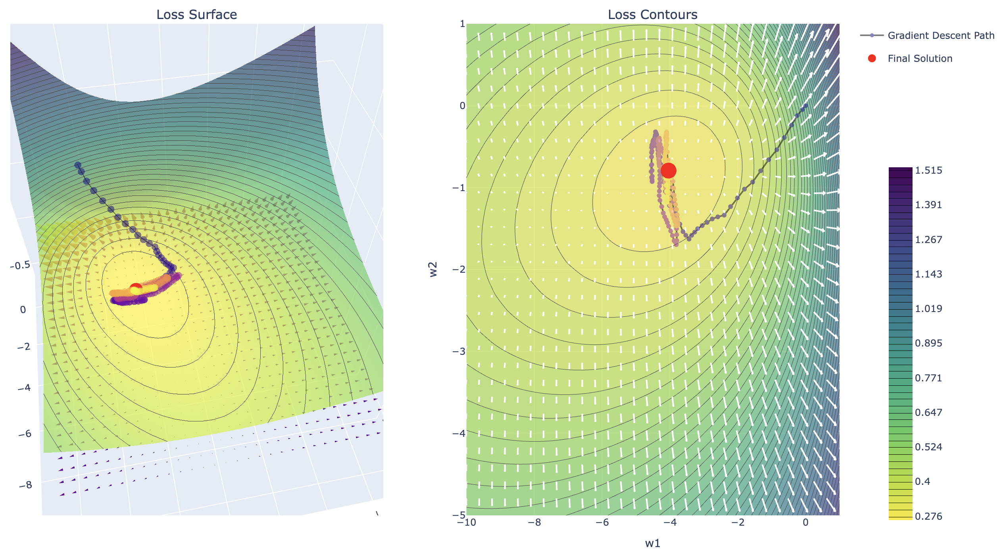
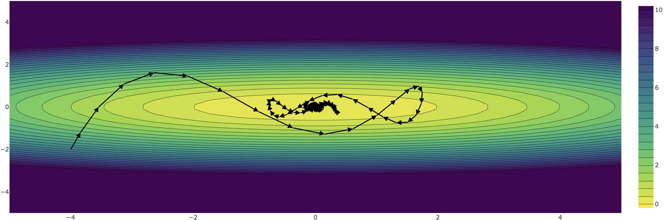
Demo
Momentum

Slide 31
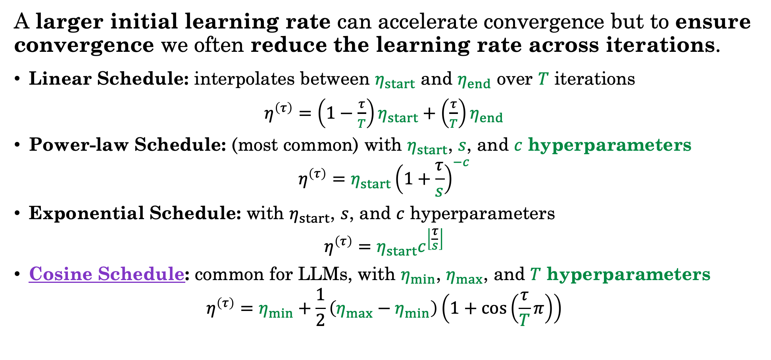
Learning Rate Schedules
A larger initial learning rate can accelerate convergence but to ensure convergence we often reduce the learning rate across iterations.
Linear Schedule: interpolates between $η_{start}$ and $η_{end}$ over $T$ iterations
$η^{\left(τ\right)}=\left(1−\frac{τ}{T}\right)η_{start}+\left(\frac{τ}{T}\right)η_{end}$
Power-law Schedule: (most common) with $η_{start}$, $s$, and $c$ hyperparameters
$$η^{\left(τ\right)}=η_{start}{\left(1+\frac{τ}{s}\right)}^{−c}$$
Exponential Schedule: with $η_{start}$, $s$, and $c$ hyperparameters
$$η^{\left(τ\right)}=η_{start}c^{\left\lfloor \frac{τ}{s}\right\rfloor }$$
Cosine Schedule: common for LLMs, with $η_{min}$, $η_{max}$, and $T$ hyperparameters
$$η^{\left(τ\right)}=η_{min}+\frac{1}{2}\left(η_{max}−η_{min}\right)\left(1+\cos\left(\frac{τ}{T}π\right)\right)$$

Slide 32
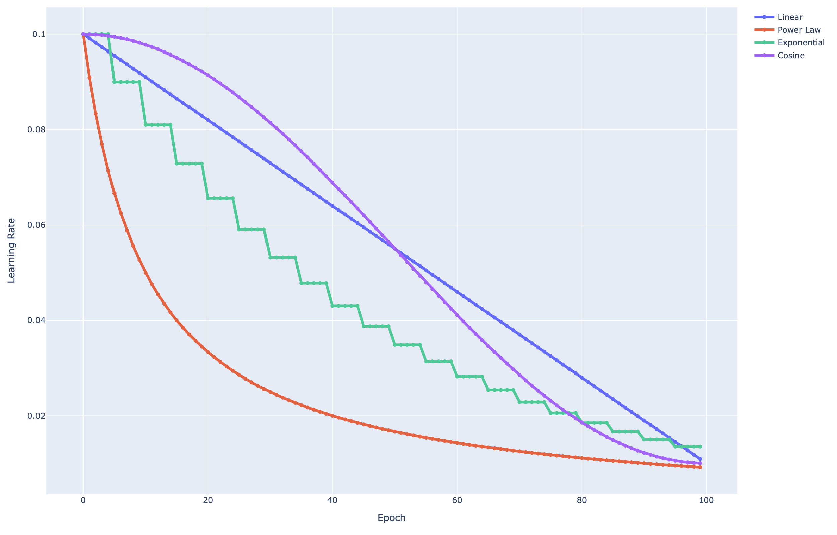
Demo
Learning Rate Schedules

Slide 33
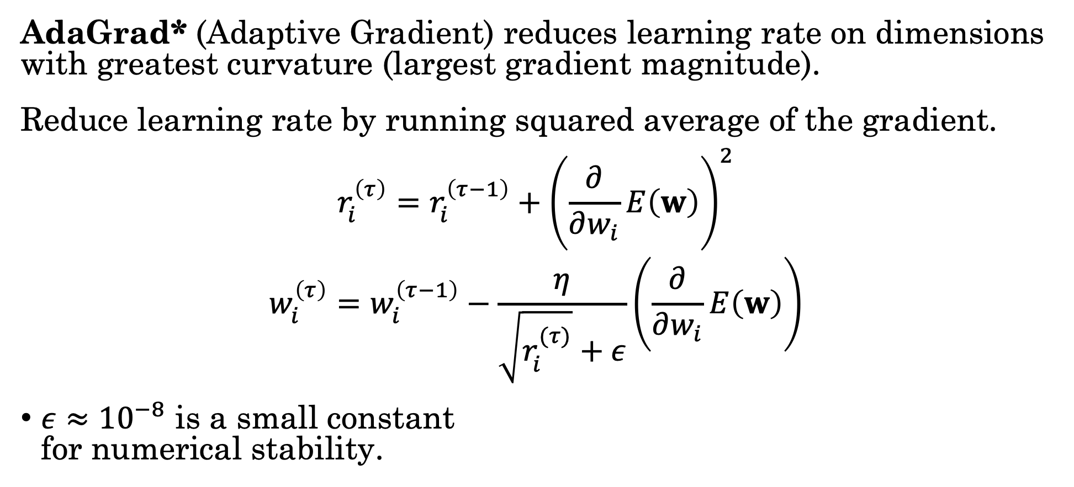
Adaptive Learning Rates – AdaGrad
AdaGrad* (Adaptive Gradient) reduces learning rate on dimensions with greatest curvature (largest gradient magnitude).
Reduce learning rate by running squared average of the gradient.
$$r_{i}^{\left(τ\right)}=r_{i}^{\left(τ−1\right)}+{\left(\frac{∂}{∂w_{i}}E\left(w\right)\right)}^{2}$$
$$w_{i}^{\left(τ\right)}=w_{i}^{\left(τ−1\right)}−\frac{η}{\sqrt{r_{i}^{(τ)}}+ε}\left(\frac{∂}{∂w_{i}}E\left(w\right)\right)$$
$ε≈{10}^{−8}$ is a small constant for numerical stability.
Tracking Magnitude
(terms squared)
Issue:
Large initial gradients result in overly small learning rates near convergence.
Scaled Learning Rate
*Developed at UC Berkeley

Slide 34
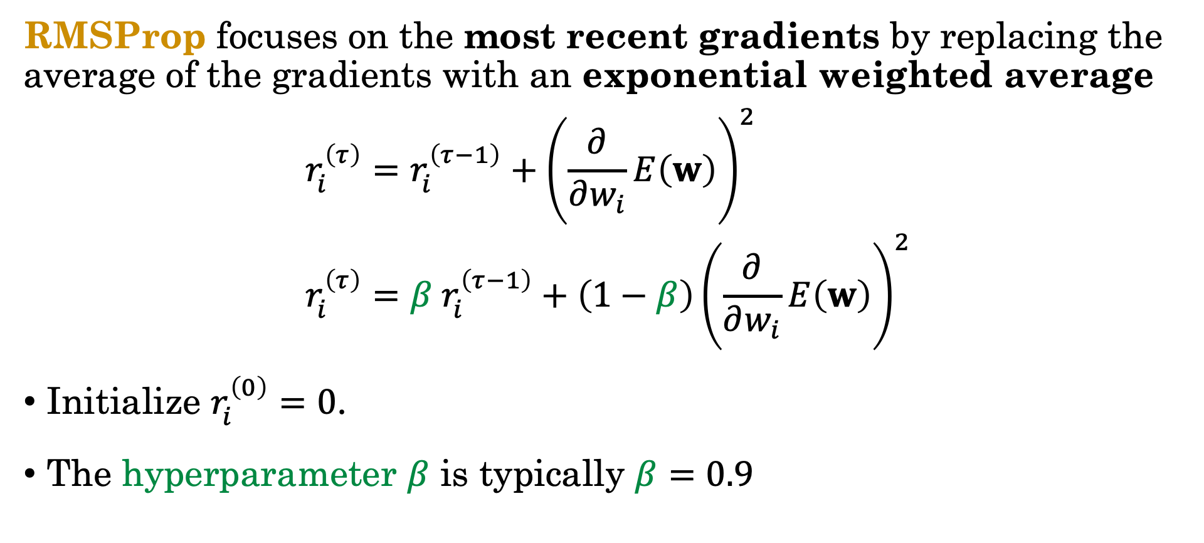
Adaptive Learning Rates – RMSProp
RMSProp focuses on the most recent gradients by replacing the average of the gradients with an exponential weighted average
$$r_{i}^{\left(τ\right)}=r_{i}^{\left(τ−1\right)}+{\left(\frac{∂}{∂w_{i}}E\left(w\right)\right)}^{2}$$
$$r_{i}^{\left(τ\right)}=β r_{i}^{\left(τ−1\right)}+\left(1−β\right){\left(\frac{∂}{∂w_{i}}E\left(w\right)\right)}^{2}$$
Initialize $r_{i}^{\left(0\right)}=0$.
The hyperparameter $β$ is typically $β=0.9$
AdaGrad
RMSProp

Slide 35

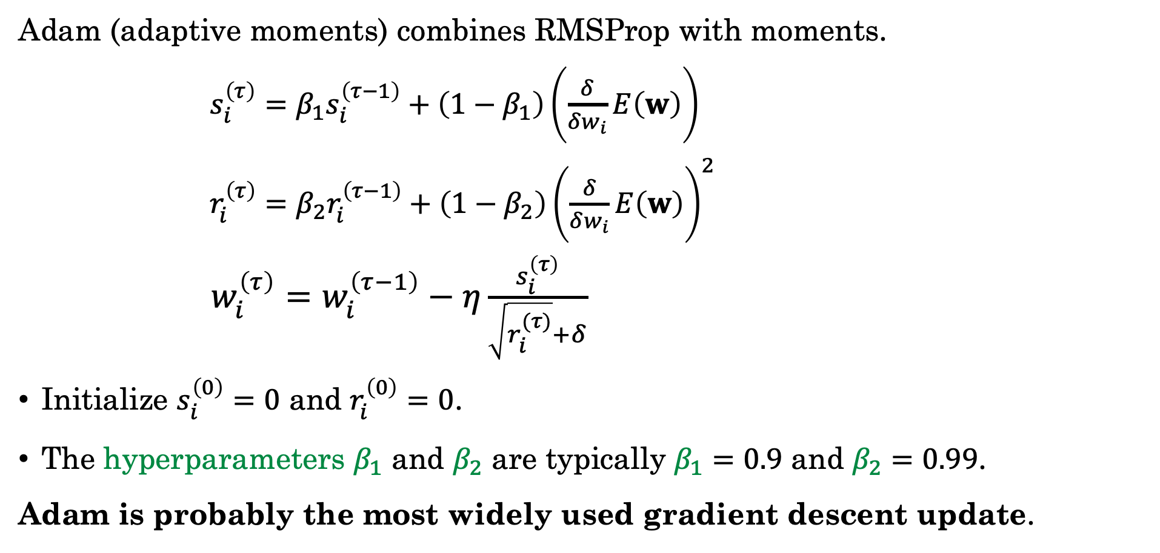
Adam = RMSProp + Momentum
Adam (adaptive moments) combines RMSProp with moments.
$s_{i}^{\left(τ\right)}=β_{1}s_{i}^{\left(τ−1\right)}+\left(1−β_{1}\right)\left(\frac{δ}{δw_{i}}E\left(w\right)\right)$
$r_{i}^{\left(τ\right)}=β_{2}r_{i}^{\left(τ−1\right)}+\left(1−β_{2}\right){\left(\frac{δ}{δw_{i}}E\left(w\right)\right)}^{2}$
$w_{i}^{\left(τ\right)}=w_{i}^{\left(τ−1\right)}−η\frac{s_{i}^{\left(τ\right)}}{\sqrt{r_{i}^{(τ)}}+δ}$
Initialize $s_{i}^{\left(0\right)}=0$ and $r_{i}^{\left(0\right)}=0$.
The hyperparameters $β_{1}$ and $β_{2}$ are typically $β_{1}=0.9$ and $β_{2}=0.99$.
Adam is probably the most widely used gradient descent update.
Momentum
Bias Corrected Version:
${\hat{s}}_{i}^{\left(τ\right)}=\frac{s_{i}^{\left(τ\right)}}{1−β_{1}^{τ}}$
${\hat{r}}_{i}^{\left(τ\right)}=\frac{r_{i}^{\left(τ\right)}}{1−β_{2}^{τ}}$
$w_{i}^{\left(τ\right)}=w_{i}^{\left(τ−1\right)}−\frac{η}{\sqrt{{\hat{r}}_{i}^{(τ)}}+δ}{\hat{s}}_{i}^{\left(τ\right)}$
Addresses issue where early steps are too small.
RMSProp
Gradient
Update

Slide 36
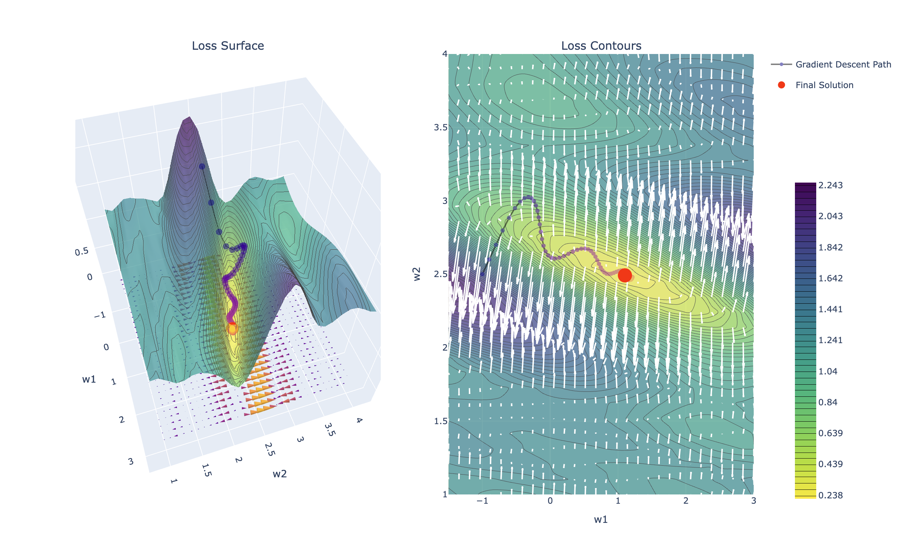
Demo
Adam

Slide 37
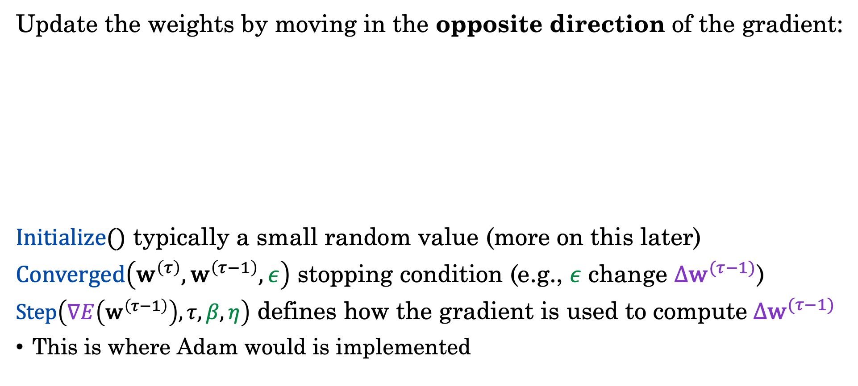
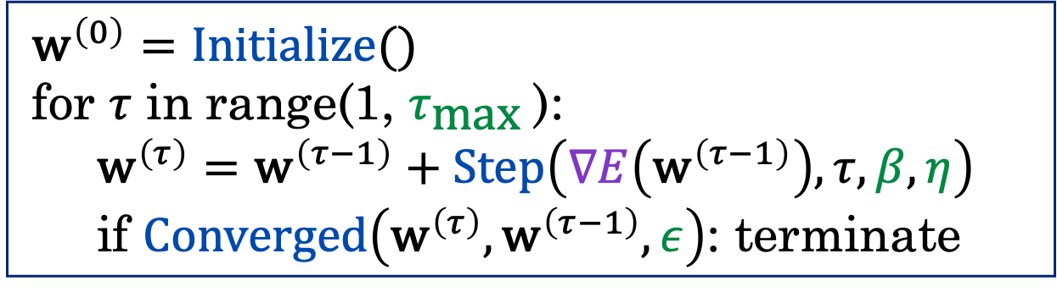
Recap: Batch Gradient Descent
Update the weights by moving in the opposite direction of the gradient:
$Initialize()$ typically a small random value (more on this later)
$Converged\left({\text{w}}^{\left(τ\right)},{\text{w}}^{\left(τ−1\right)},ε\right)$ stopping condition (e.g., $ε$ change ${Δ\text{w}}^{(τ−1)}$)
$Step\left(∇E\left({\text{w}}^{\left(τ−1\right)}\right),τ, β,η\right)$ defines how the gradient is used to compute${Δ\text{w}}^{(τ−1)}$
This is where Adam would is implemented
$${\text{w}}^{\left(0\right)}=Initialize()$$
for $τ$ in range(1, $τ_{\text{max}}$):
$${\text{w}}^{\left(τ\right)}={\text{w}}^{\left(τ−1\right)}+Step\left(∇E\left({\text{w}}^{\left(τ−1\right)}\right),τ, β,η\right)$$
if $Converged\left({\text{w}}^{\left(τ\right)},{\text{w}}^{\left(τ−1\right)}, ε\right)$: terminate
Notes:
Add tau max

Slide 38
Stochastic Gradient Descent
Approximating Gradient Descent

Slide 39
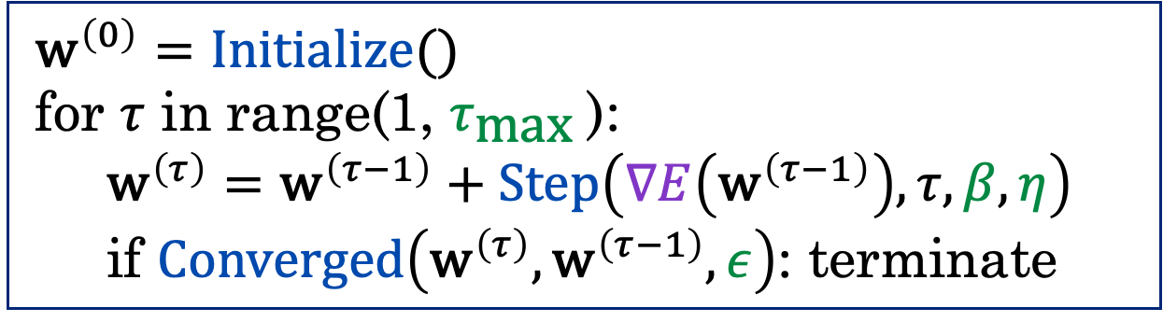

The Cost of Batch Gradient Descent
What is the cost of each iteration of batch gradient descent?
If we have $N$ training data points in $D$ dimensions:
$$∇E\left({\text{w}}^{\left(τ−1\right)}\right)=∇E\left({\text{w}}^{\left(τ−1\right)};{\left\{\left(x_{n},t_{n}\right)\right\}}_{n=1}^{N}\right)=\frac{1}{N}\sum_{n=1}^{N}{∇L\left(t_{n}, f_{{\text{w}}^{\left(τ−1\right)}}\left(x_{n}\right)\right)}$$
$${\text{w}}^{\left(0\right)}=Initialize()$$
for $τ$ in range(1, $τ_{\text{max}}$):
$${\text{w}}^{\left(τ\right)}={\text{w}}^{\left(τ−1\right)}+Step\left(∇E\left({\text{w}}^{\left(τ−1\right)}\right),τ, β,η\right)$$
if $Converged\left({\text{w}}^{\left(τ\right)},{\text{w}}^{\left(τ−1\right)}, ε\right)$: terminate

Slide 40
Do not edit How to change the design
What is the cost for a single gradient update assuming N data points in D dimensions and the basic gradient update equation.
The Slido app must be installed on every computer you’re presenting from

Slide 41



The Cost of Batch Gradient Descent
What is the cost of each iteration of batch gradient descent?
If we have $N$ training data points in $D$ dimensions:
$$∇E\left({\text{w}}^{\left(τ−1\right)}\right)=∇E\left({\text{w}}^{\left(τ−1\right)};{\left\{\left(x_{n},t_{n}\right)\right\}}_{n=1}^{N}\right)=\frac{1}{N}\sum_{n=1}^{N}{∇L\left(t_{n}, f_{{\text{w}}^{\left(τ−1\right)}}\left(x_{n}\right)\right)}$$
The cost per update is $𝒪(ND)$
$${\text{w}}^{\left(0\right)}=Initialize()$$
for $τ$ in range(1, $τ_{\text{max}}$):
$${\text{w}}^{\left(τ\right)}={\text{w}}^{\left(τ−1\right)}+Step\left(∇E\left({\text{w}}^{\left(τ−1\right)}\right),τ, β,η\right)$$
if $Converged\left({\text{w}}^{\left(τ\right)},{\text{w}}^{\left(τ−1\right)}, ε\right)$: terminate
$$𝒪(N)$$
$$𝒪(D)$$

Slide 42

The Training Error Estimates the Test Error
As an optimizer, our goal has been to minimize the average training error:
$$E_{train}\left[w\right]=\frac{1}{N}\sum_{n=1}^{N}{L(t_{n};f_{\text{w}}\left(x_{n}\right))}$$
However, we would have preferred to minimize the expected test error:
$$E_{test}\left[w\right]=𝔼_{p\left({t_{∗},x}_{∗}\right)}\left[L\left(t_{∗},f_{\text{w}}\left(x_{∗}\right)\right)\right]$$
Where $p\left({t_{∗},x}_{∗}\right)$ is the unknown distribution over test examples.
If we assume that our training data is drawn from $p\left({t_{∗},x}_{∗}\right)$ then for large enough $N$:
$$E_{train}\left[w\right]=\frac{1}{N}\sum_{n=1}^{N}{L(t_{n};f_{\text{w}}\left(x_{n}\right))}≈𝔼_{p\left({t_{∗},x}_{∗}\right)}\left[L\left(t_{∗},f_{\text{w}}\left(x_{∗}\right)\right)\right]=E_{test}\left[w\right]$$
The training error is an empirical estimate of the unknown test error.

Slide 43


Approximating the Gradient
The error (and the gradient) are empirical expectations of the test error:
$$E\left({\text{w}}^{\left(τ−1\right)}\right)=\frac{1}{N}\sum_{n=1}^{N}{L\left(t_{n}, f_{{\text{w}}^{\left(τ−1\right)}}\left(x_{n}\right)\right)}≈𝔼_{p\left(t,x\right)}\left[L\left(t, f_{{\text{w}}^{\left(τ−1\right)}}\left(x\right)\right)\right]$$
The error at a single point is also a (noisy) estimate:
$$E_{n}\left({\text{w}}^{\left(τ−1\right)}\right)=L\left(t_{n}, f_{{\text{w}}^{\left(τ−1\right)}}\left(x_{n}\right)\right)≈𝔼_{p\left(t,x\right)}\left[L\left(t, f_{{\text{w}}^{\left(τ−1\right)}}\left(x\right)\right)\right]$$
Compute the gradient for a randomly (stochastically) sampled single point:
$$∇E_{n}\left({\text{w}}^{\left(τ−1\right)}\right)≈∇E\left({\text{w}}^{\left(τ−1\right)};{\left\{\left(x_{n},t_{n}\right)\right\}}_{n=1}^{N}\right)≈𝔼_{p\left(t,x\right)}\left[∇L\left(t, f_{{\text{w}}^{\left(τ−1\right)}}\left(x\right)\right)\right]$$
Cheap approx.
Best estimate (but expensive)
Ideal but don’t know $p\left(t,x\right)$

Slide 44



Stochastic Gradient Descent
Gradient descent but with the gradient computed on a single randomly sampled training data point
Stochasticity comes from random gradient estimates $∇E_{n}\left({\text{w}}^{\left(τ−1\right)}\right)$
Cost per step is $𝓞(D)$ instead of $𝒪(ND)$ in batch gradient descent
Gradient of the error on the $n^{\text{th}}$ data point.
$$∇E_{n}\left({\text{w}}^{\left(τ−1\right)}\right)=∇L\left(t_{n}, f_{{\text{w}}^{\left(τ−1\right)}}\left(x_{n}\right)\right)$$
$${\text{w}}^{\left(0\right)}=Initialize()$$
for $τ$ in range(1, $τ_{\text{max}}$):
$$n=\text{RandomInteger}(0,N)$$
$${\text{w}}^{\left(τ\right)}={\text{w}}^{\left(τ−1\right)}+Step\left(∇E_{n}\left({\text{w}}^{\left(τ−1\right)}\right),τ, β,η\right)$$
if $Converged\left({\text{w}}^{\left(τ\right)},{\text{w}}^{\left(τ−1\right)}, ε\right)$: terminate

Slide 45


Stochastic Gradient Descent (Shuffling)
In practice, we often shuffle and then iterate over the entire dataset
One epoch is a complete pass over all the data points.
${\text{w}}^{\left(0\right)}=Initialize()$;
$$τ=1$$
for $e$ in range(0, $e_{\text{max}}$): # Epochs
$ShuffleData()$ # Randomize the Data Ordering
for $n$ in range(0, $n$):
${\text{w}}^{\left(τ\right)}={\text{w}}^{\left(τ−1\right)}+Step\left(∇E_{n}\left({\text{w}}^{\left(τ−1\right)}\right),τ, β,η\right)$
if $Converged\left({\text{w}}^{\left(τ\right)},{\text{w}}^{\left(τ−1\right)},ε\right)$: terminate
$$τ=τ+1$$
Often only randomize data once.
Gradient of the error on the $n^{\text{th}}$ data point.

Slide 46

Demo
Stochastic Gradient Descent

Slide 47






A Better Gradient Approximation
Estimating the gradient using a single data point results in noisy estimates.
$$𝔼_{p\left(t,x\right)}\left[∇L\left(t, f_{{\text{w}}^{\left(τ−1\right)}}\left(x\right)\right)\right]$$
Noisy but Cheap
Accurate but Expensive
$$\frac{1}{N}\sum_{n=1}^{N}{∇L\left(t_{n}, f_{{\text{w}}^{\left(τ−1\right)}}\left(x_{n}\right)\right)}$$
Ideal but don’t know $p\left(t,x\right)$
$$∇L\left(t_{n}, f_{{\text{w}}^{\left(τ−1\right)}}\left(x_{n}\right)\right)$$
?
Stochastic Gradient Descent
Batch Gradient Descent
Mini-Batch Stochastic Gradient Descent
$$\frac{1}{B}\sum_{b=1}^{B}{∇L\left(t_{ℬ_{b}}, f_{{\text{w}}^{\left(τ−1\right)}}\left(x_{ℬ_{b}}\right)\right)}$$
Where $ℬ$ is a random sample of $B$ data points called a mini-batch.

Slide 48








A Spectrum of Stochastic Gradients
We typically refer to any of the sampling based gradient estimation procedures as Stochastic Gradient Descent (SGD)
Noisy but Cheap
Accurate but Expensive
$$𝔼_{p\left(t,x\right)}\left[∇L\left(t, f_{{\text{w}}^{\left(τ−1\right)}}\left(x\right)\right)\right]$$
$$\frac{1}{B}\sum_{b=1}^{B}{∇L\left(t_{ℬ_{b}}, f_{{\text{w}}^{\left(τ−1\right)}}\left(x_{ℬ_{b}}\right)\right)}$$
$$\frac{1}{N}\sum_{n=1}^{N}{∇L\left(t_{n}, f_{{\text{w}}^{\left(τ−1\right)}}\left(x_{n}\right)\right)}$$
Ideal but don’t know $p\left(t,x\right)$
$$∇L\left(t_{n}, f_{{\text{w}}^{\left(τ−1\right)}}\left(x_{n}\right)\right)$$
Stochastic Gradient Descent
Mini-Batch Stochastic Gradient Descent
Batch Gradient Descent
$𝒪(D)$
$𝒪(BD)$
$𝒪(ND)$
Stochastic Gradient Methods

Slide 49



Mini-batch Stochastic Gradient Descent
Gradient descent but with the gradient computed on a batch of randomly sampled training points
Cost per step is $𝓞(BD)$ instead of $𝒪(ND)$ in batch gradient descent
Note that at batch size $B=1$ mini-batch is the same as SGD
We often call both algorithms SGD (just with a batch-size hyperparameter)
$$∇E_{ℬ}\left({\text{w}}^{\left(τ−1\right)}\right)=\frac{1}{B}\sum_{b=1}^{B}{∇L\left(t_{ℬ_{b}}, f_{{\text{w}}^{\left(τ−1\right)}}\left(x_{ℬ_{b}}\right)\right)}$$
$${\text{w}}^{\left(0\right)}=Initialize()$$
for $τ$ in range(1, $τ_{\text{max}}$):
$$ℬ=\text{RandBatch}(0,N, \text{size}=B)$$
$${\text{w}}^{\left(τ\right)}={\text{w}}^{\left(τ−1\right)}+Step\left(∇E_{ℬ}\left({\text{w}}^{\left(τ−1\right)}\right),τ, β,η\right)$$
if $Converged\left({\text{w}}^{\left(τ\right)},{\text{w}}^{\left(τ−1\right)},ε\right)$: terminate

Slide 50


Shuffling for Minibatch Gradient Descent
In practice, we often shuffle and then iterate over the entire dataset
One epoch is a complete pass over all the data points.
${\text{w}}^{\left(0\right)}=Initialize()$;
$$τ=1$$
for $e$ in range(0, $e_{\text{max}}$): # Epochs
$ShuffleData()$ # Randomize the Data Ordering
for $n$ in range(0, $n$, step=B):
$${\text{w}}^{\left(τ\right)}={\text{w}}^{\left(τ−1\right)}+Step\left(∇E_{n,…,n+B}\left({\text{w}}^{\left(τ−1\right)}\right),τ, β,η\right)$$
if $Converged\left({\text{w}}^{\left(τ\right)},{\text{w}}^{\left(τ−1\right)},ε\right)$: terminate
$$τ=τ+1$$
Often only randomize data once.
Gradient of the error on the next $B$ data points.

Slide 51
Do not edit How to change the design
If I have N data points and a choose a batchsize B=2. In one epoch how many gradient steps will I take?
The Slido app must be installed on every computer you’re presenting from

Slide 52
How do I Pick the Batch Size?
Larger batch size:
Better gradient estimate
Enables hardware parallelism – can compute gradient for each point in parallel
Smaller batch size:
Cheap to compute → take more steps
Greater stochasticity can help with local minima
Typical design decision:
Increase batch size to saturate hardware parallelism
Increase learning rate proportional to batch size (take bigger steps)

Slide 53

Demo
Mini-batch Gradient Descent

Slide 54
Stochastic Gradient Descent
Lecture 13
Credit: Joseph E. Gonzalez and Narges Norouzi
Reference Book Chapters: Chapter 7

